Slide 1
Transport layer
IN2140:
Introduction to Operating Systems and Data Communication
Flow Control

Slide 2
Flow Control on Transport Layer
Fast sender shall not flood slow receiver
Application
Layer
Transport
Layer
Network
Layer
Data Link
Layer
Link layer
Few connections
(one per host)
Short distances
Physical
Layer
Transport layer
Potentially many connections
(several per application)
Potentially long distances
Flow control mechanisms:
Stop-and-wait
Sliding window
  Go-back-N / no buffer allocation
  Selective repeat / static buffer allocation
  Credit mechanism / dynamic buffer allocation

Slide 3
Flow control and error treatment
Problem
sender can send faster than receiver can receive
Without flow control
receiver loses packets despite error-free transmission
With flow control
sender can adapt to receiver’s abilities by feedback
Comment
error control and flow control are usually interlinked
rate control
  controls sending speed as well
  but defines sequencing of send operations
  whereas flow control defines conditions for next send operation
© Ralf Steinmetz, Technische Universität Darmstadt

Slide 4
Transport layer
IN2140:
Introduction to Operating Systems and Data Communication
Flow Control: stop-and-wait

Slide 5


Flow control: Stop-and-Wait
sender
receiver
packet
Needed:
(A) a receiving buffer
(B) bi-directional communication
ACK
packet
ACK

Slide 6
Flow control: Stop-and-Wait
Packets can get lost
sender
receiver
sender
receiver
packet
packet
ACK
ACK
packet
Features required by Stop-and-Wait:
fix the loss
distinguish packet loss and ACK loss

Slide 7
Flow control: Stop-and-Wait
(a) fix the loss
sender
receiver
start a timer
packet
timer expired
send packet again
start new timer
packet
ACK
ACK arrived
cancel timer
Timeout interval:
Too short: unnecessary sending of packets
Too long: unnecessary long wait in case of error

Slide 8
Flow control: Stop-and-Wait
(b) distinguish packet loss and ACK loss
sender
receiver
sender
receiver
packet 0
packet 0
packet 0
expected
packet 0
expected
ACK
packet 0 or
packet 1?
packet 0 or
packet 1?
packet 1 expected
ACK
ACK
packet 1 expected

Slide 9
Flow control: Stop-and-Wait
Distinguish cases by sequence number: single bit with value 0 and 1
sender
receiver
sender
receiver
packet 0
expected
packet 0 expected
packet
0
packet
0
packet 1 expected
received 0
ACK
0
packet
0
packet
0
packet 1
expected
packet 1 expected
received
discard 0
ACK
0
ACK
0
packet
1
packet
1
packet 0
expected
packet 0 expected
received
received 1
ACK
1
ACK
1

Slide 10
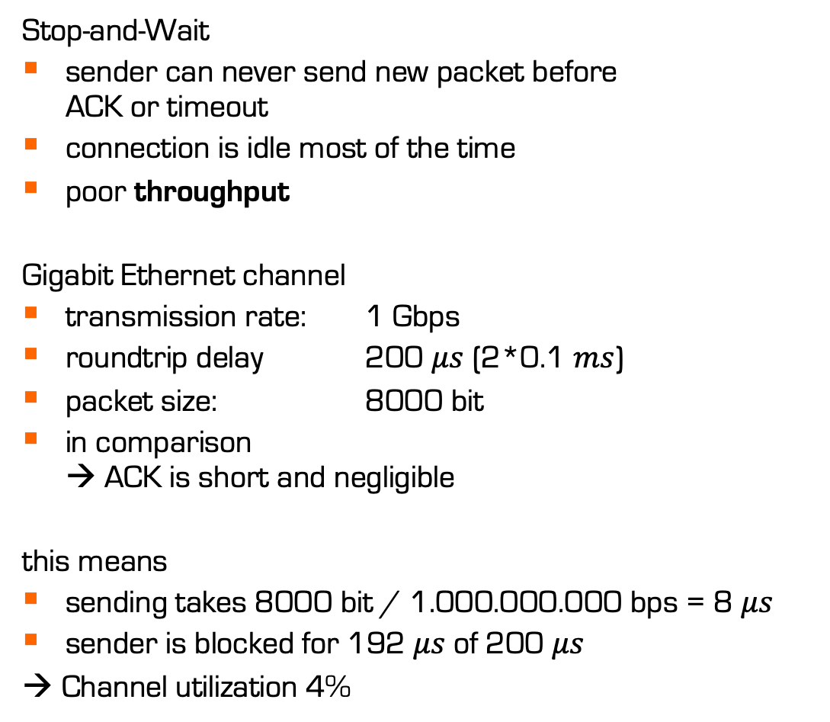


Flow control: Stop-and-Wait
Stop-and-Wait
sender can never send new packet before
ACK or timeout
connection is idle most of the time
poor throughput
Gigabit Ethernet channel
transmission rate: 1 Gbps
roundtrip delay 200 $μs$ (2*0.1 $ms$)
packet size: 8000 bit
in comparison
→ ACK is short and negligible
this means
sending takes 8000 bit / 1.000.000.000 bps = 8 $μs$
sender is blocked for 192 $μs$of 200 $μs$
→ Channel utilization 4%
sender
receiver
$8 μ$s
packet
$200 μ$s
ACK

Slide 11
Transport layer
IN2140:
Introduction to Operating Systems and Data Communication
Flow Control: sliding window

Slide 12
Flow control: Sliding Window
Improve utilization: pipelining
Flow control: sliding window mechanism
sender
receiver
packet 0
packet 1
packet 2
ACK 0
ACK 1
ACK 2
packet 8
ACK 8

Slide 13
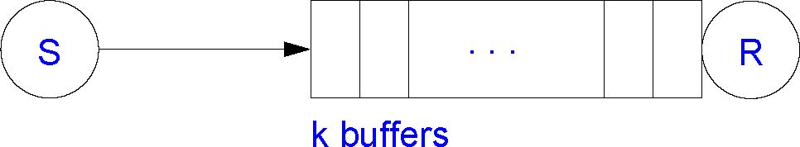
Sliding Window: Concept
1st goal of link flow control:
receiver buffer must not overflow
Assumptions:
each buffer can contain one packet
Two windows per communication relationship
Sender Window (or Send Window)
packets that were sent but not yet acknowledged
Receiver Window (or Receive Window)
packets that can be accepted
packets are identified
by sequence numbers
but the packets keep coming
and these numbers will
wrap eventually
send
w
e
s
e
n
d
s
o
m
e
d
a
t
a
f
r
o
m
t
h
e
t
o
p
buffers that fit into the current send window can be
in flight at the same time
(“in flight”: sent but not acknowledged)
s
d
n
recv
w
e
s
e
packets that fit into the current receive window
are considered valid and are acknowledged on arrival
Notes:
flood : overflomme

Slide 14
Sliding Window: Concept
Example:
SeqNo: [0..7]
Window Size (WS): 3
Sender side
LB
0
lower bound
0
2 variables
UB
0
upper bound
0
7
0
LB: oldest seqno that is still unconfirmed
UB: next seqno to be sent
if LB==UB :
nothing is in flight
sender is idle
Sender
6
1
5
2
4
3
advancing sender seqno (modulo 8)
LB: when ACK is received
UB: when sending a packet

Slide 15
Sliding Window: Concept
Example:
SeqNo: [0..7]
Window Size (WS): 3
Sender side
LB
1
lower bound
0
2 variables
UB
3
0
1
upper bound
2
7
0
LB: oldest seqno that is still unconfirmed
UB: next seqno to be sent
if LB==UB :
nothing is in flight
sender is idle
Sender
6
1
5
2
4
3
increase UB (modulo 8 !)
when sending a packet
increase LB (modulo 8 !)
when receiving an ACK
send packet(0) packet(1) packet(2) WS=3
recv ACK(0): WS=2

Slide 16
Sliding Window: Concept
Example:
SeqNo: [0..7]
Window Size (WS): 3
Sender side
LB
1
2
3
lower bound
4
2 variables
3
4
5
UB
7
upper bound
6
7
0
LB: oldest seqno that is still unconfirmed
UB: next seqno to be sent
if LB==UB :
nothing is in flight
sender is idle
Sender
6
1
5
2
4
3
increase UB (modulo 8 !)
when sending a packet
increase LB (modulo 8 !)
when receiving an ACK
send packet(0) packet(1) packet(2) WS=3
recv ACK(0): WS=2
send packet(3) WS=3
recv ACK(1), ACK(2), ACK(3) WS=0
send packet(4) packet(5) packet(6) WS=3

Slide 17
Sliding Window: Concept
Example:
SeqNo: [0..7]
Window Size (WS): 3
Receiver side
LB
0
lower bound
1
2 variables
3
upper bound
UB
4
7
0
LB: lowest valid seqno that should be ACKed
UB: lowest invalid seqno
if UB==LB: buffer full
if UB==(LB+3)%8: nothing to ACK
Receiver
6
1
5
2
4
3
increase LB (modulo 8 !)
when receiving a packet
increase UB (modulo 8 !)
when sending an ACK
recv packet(0) … WS=2
send ACK(0) WS=3

Slide 18
Sliding Window: Concept
Example:
SeqNo: [0..7]
Window Size (WS): 3
Receiver side
LB
3
1
2
lower bound
4
2 variables
7
6
5
upper bound
UB
4
7
0
LB: lowest valid seqno that should be ACKed
UB: lowest invalid seqno
if UB==LB: buffer full
if UB==(LB+3)%8: nothing to ACK
Receiver
6
1
5
2
4
3
increase LB (modulo 8 !)
when receiving a packet
increase UB (modulo 8 !)
when sending an ACK
recv packet(0) … WS=2
send ACK(0) WS=3
recv packet(1) packet(2) packet(3) WS=0
send ACK(1) ACK(2) ACK(3) WS=3

Slide 19
Transport layer
IN2140:
Introduction to Operating Systems and Data Communication
Flow Control: cumulative ACK

Slide 20
Sliding Window: Concept
Example:
SeqNo: [0..7]
Window Size (WS): 3
Feature: Cumulative ACK
sender
receiver
LB
0
LB
0
packet 0
1
packet 1
0
3
UB
3
packet 2
ACK 0
UB
4
7
0
7
0
Sender
Receiver
6
1
6
1
5
2
5
2
4
3
4
3

Slide 21
Sliding Window: Concept
Example:
SeqNo: [0..7]
Window Size (WS): 3
Feature: Cumulative ACK
sender
receiver
LB
0
3
LB
3
packet 0
3
packet 1
3
4
UB
packet 2
ACK 0
UB
6
ACK 0
7
0
ACK 1
7
0
Sender
ACK 2
Receiver
6
1
6
1
5
2
5
2
4
3
4
3

Slide 22
Sliding Window: Concept
Example:
SeqNo: [0..7]
Window Size (WS): 3
Feature: Cumulative ACK
sender
receiver
LB
0
3
LB
3
6
packet 0
3
packet 1
UB
6
packet 2
UB
6
ACK 0
7
0
ACK 1
7
0
Sender
ACK 2
packet 3
Receiver
6
1
packet 4
6
1
packet 5
5
2
5
2
4
3
4
3

Slide 23
Sliding Window: Concept
Example:
SeqNo: [0..7]
Window Size (WS): 3
Feature: Cumulative ACK
With cumulative ACKs:
ACK 5 confirms everything up to 5
sender
receiver
LB
0
3
LB
3
4
6
packet 0
6
packet 1
3
6
7
1
UB
packet 2
UB
0
ACK 0
7
0
ACK 1
7
0
Sender
ACK 2
packet 3
Receiver
6
1
packet 4
6
1
packet 5
5
2
ACK 3
ACK 4
5
2
4
3
4
3
ACK 5
Without cumulative ACKs:
timeout & retransmission

Slide 24
Sliding Window
Stored packets at the sender
the sender must store all unacknowledged packets and be able to retransmit
maximum number defined by sender’s window size (here 3)
the packets not yet acknowledged by the receiver
Stored packets at the receiver
not necessary to store any packets
  receive buffer must hold at least one packet, but can be passed to next layer right away
not useful to store more than one receiver window size
ACK sent by receiver only if the packet
has been identified as being correct
can be transmitted correctly to the application
  correct includes “in the right order”
  correct includes usually: free from detected bit errors

Slide 25
Transport layer
IN2140:
Introduction to Operating Systems and Data Communication
Flow Control: retransmission

Slide 26
Sliding Window
Retransmission approaches
sender
receiver
packet 1
packet 0
This approach is called
Go-Back-N
Receiver accepts packets only in order
Advantages:
receiver needs only buffer for 1 packet
if the network usually looses >1 packets in a row, this fixes the problem quickly
packet 2
ACK 0
discard 2
packet 3
discard 3
packet 1
packet 2
packet 3
ACK 1
ACK 2
ACK 3
packet 4

Slide 27
Sliding Window
Retransmission approaches
sender
receiver
sender
receiver
packet 1
packet 0
packet 1
packet 0
packet 2
packet 2
ACK 0
ACK 0
keep 2
packet 3
ACK 0
packet 3
keep 3
packet 1
packet 1
packet 2
ACK 0
packet 3
ACK 1
ACK 3
ACK 2
ACK 3
packet 4
packet 4

Slide 28
Sliding Window
Retransmission approaches
sender
receiver
This approach is called
Selective Repeat
Receiver buffers packets that arrive out of order but in window
Advantages:
less traffic
if the network usually looses only 1 packet in a row, this uses bandwidth better
packet 1
packet 0
packet 2
ACK 0
keep 2
ACK 0
packet 3
keep 3
packet 1
ACK 0
ACK 3
packet 4

