Slide 1
Transport layer
IN2140:
Introduction to Operating Systems and Data Communication
Terminology

Slide 2
Terminology: bandwidth (1/2)
Mirriam-Webster online ( http://www.m-w.com ):
Main Entry: band*width, Pronunciation: 'band-"width
Function: noun, Date: circa 1937
  1 : a range within a band of wavelengths, frequencies, or energies; especially : a range of radio frequencies which is occupied by a modulated carrier wave, which is assigned to a service, or over which a device can operate
  2 : the capacity for data transfer of an electronic communications system <graphics consume more bandwidth than text does>; especially : the maximum data transfer rate of such a system
Unit: definition 1 - “Hz“, definition 2 - “bit/s“ (bps)
Common terminology in computer network context:
How many bits/sec can be transferred = “how thick is the pipe”
Traditional, “real“ definition!
“Information rate“

Slide 3
Terminology: bandwidth (2/2)
Various wooly “bandwidth“ terms
  Nominal bandwidth: Bandwidth of a link when there is no traffic
  Available bandwidth: (Nominal bandwidth - traffic) ... during a specific interval
  Bottleneck bandwidth: smallest nominal bandwidth along a path, but sometimes also smallest available bandwidth along a path
Throughput: bandwidth seen by the receiver
Goodput: bandwidth seen by the receiving application
  e.g. TCP: goodput != throughput
  Difference is not only message headers - more required to ensure reliability, ordering, flow control, congestion control, ...
Notes:
Nominell – tilgjengelig – flaskehals
Flytkontroll - metningkontroll

Slide 4
Terminology: delay
Propagation delay - time to transfer a bit
Latency = propagation delay
+ msg_length / bottleneck bandwidth
+ queuing delay
  just a rough measure; e.g., processing delay can also
  play a role, esp. in core routers (CPU = scarce resource!)
Jitter - delay fluctuations, very critical for most real-time applications
End-to-end delay – time a message needs from a sending entity to a receiving entity
  end-to-end delay on the application layer includes TCP retransmissions
  end-to-end delay on the transport layer does not
Round-trip time (RTT) - time a messages needs to go from sender to receiver and back

Slide 5
Transport layer
IN2140:
Introduction to Operating Systems and Data Communication
TCP reliability

Slide 6
TCP Reliability
TCP/IP has only two tools for ensuring reliable transfer:
  detecting duplicate byte ranges
  retransmitting data that has not arrived and not arrived correctly

Slide 7
TCP Reliability
TCP/IP Retransmits segments until they are acknowledged
ACK field is used for that
Version
IHL
Type of service
PRE
ToS
Total length
Identification
D
M
Fragment offset
Time to live
Protocol
Header checksum
IP header
Source address
Destination Address
Options
Source port
Destination port
Sequence number
Piggyback acknowledgement
TCP header
THL
unused
U
A
P
R
S
F
Window
Checksum
Urgent pointer
Options (0 or more 32 bit words)
Data
Acknowledgement:
Next expected byte
Indicator:
Is the ACK field in use

Slide 8
TCP ACK and Reliability
Timer
start
Seq=92, 8 bytes data
Seq=92, 8 bytes data
ACK=100
Seq=100, 20 bytes data
Loss!
X
Timer for 92
Timer for 100
ACK=100
ACK=120
Timeout!
Seq=92, 8 bytes data
Seq=92,
8 bytes data
Timeout!
ACK=100
Seq=120, 10 bytes data
ACK=120
time
time
time
time
Timeout retransmission
Spurious retransmission
In modern TCP implementations,
a lot is done to suppress spurious retransmissions.
The reason is that timeouts have another meaning: congestion
Notes:
Spurious = uberettiget

Slide 9
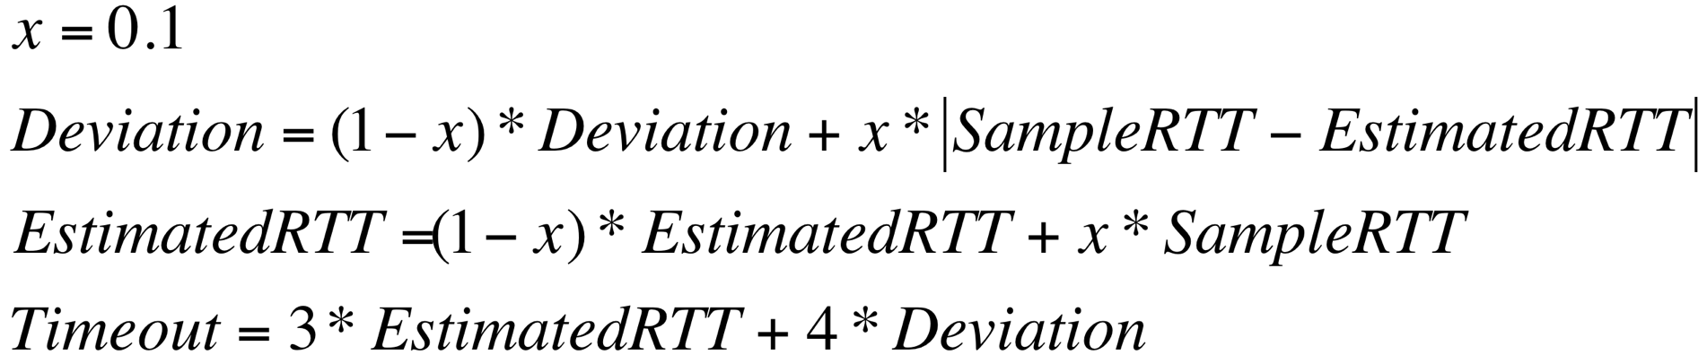
TCP Round trip time and timeout
How to set the retransmission timer?
  Must be longer than round-trip time (RTT)
  Too short: many spurious retransmissions
  Too long: slow reaction, flow control buffer fills up
Idea
  Estimated RTT
    Use a SampleRTT: Measure time from segment sending and ACK received
    Compute EstimatedRTT as a floating average
    Increase the EstimatedRTT with a safety margin that is big when SampleRTT changes a lot
      (because fewer timeouts are considered better)
Not only 1 RTT because we have also “Fast Retransmission” for fixing packet loss, explained with “Congestion”

