Slide 1
Switching
IN2140:
Introduction to Operating Systems and Data Communication
more on
Virtual Circuit Switching

Slide 2
Virtual Circuits
Connection set-up phase
  select a path
  assign a VC identifier (VC number)
  IS stores path information
  network reserves all resources required for the connection
Data transfer phase: all packets follow the selected path
  every packet contains VC number
    identification of connection, no address information
  IS uses stored path information to determine next node
  maybe update VC number in packet
Disconnect phase:
  IS releases reserved resources
  IS forgets the VC

Slide 3
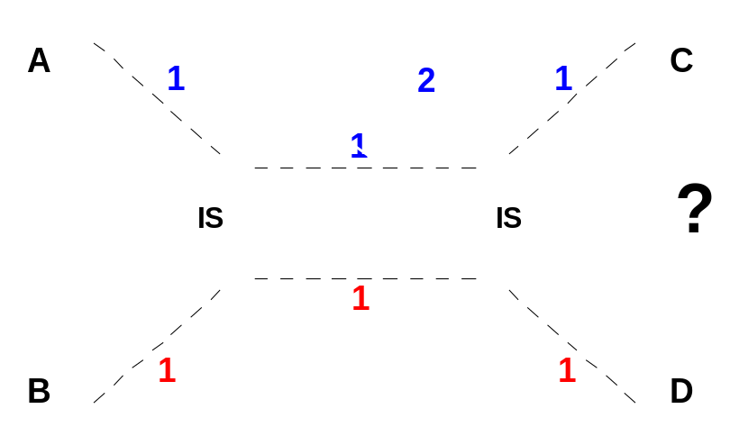
Implementation Virtual Circuit
ES allocates VC number independently (no negotiation)
Problem: the same VC identifiers may be allocated to different paths
Solution: allocate VC numbers for virtual circuit segments
  IS differentiates between incoming and outgoing VC-number
    IS receives incoming VC number in CONNECT message from previous node
    IS creates outgoing VC number
    (unique between IS and successor (IS))
    IS sends outgoing VC number in CONNECT message to next node

Slide 4
Implementation Virtual Circuit
IS
ES
H
H
B
C
H
A
D
H
B
A
0
C
0
C
E
F
H
0
C
1
H
H
H
1
A
0
B
0
D
0
A
A
1
F
0
B
1
D
1
H
2
F
1
E
0
H
0
IN
OUT
F
0
H
0
E
1
D
2
D
H
0
B
0
H
1
E
0
C
0
H
0
8 Simplex virtual circuits
B
0
E
1
C
1
H
1
H
2
B
1
F
0
H
2
Originating at A | Originating at B
H
3
E
2
F
1
H
3
H
4
E
3
C
2
F
0
E
F
A
0
F
0
E
0
D
0
0 - ABCD
0 - BCD
A
1
H
0
B
0
D
1
A
2
C
0
B
1
H
0
A
3
C
1
D
0
B
0
1 - AEFD
1 - BAE
2 - ABFD
2 - BF
3 - AEC
4 - AECDFB

Slide 5
Implementation Packet Switching
Packet passes through the network as an isolated unit
  has complete source and destination addresses
  individual route selection for each packet
  generally no resource reservation
  correct sequence not guaranteed

Slide 6
Packet Switching vs. Virtual Circuit
Packet Switching: IS routing table specifies possible path(s)
  No connection setup delay
  Less sensible to IS and link failures
  Route selection for each packet: quick reaction to failures
but
  Each packet contains the full destination and source address
  Route selection for each packet: overhead
  QoS guarantees hardly possible
Virtual Circuit: destination address defined by connection
  Packets contain short VC-number only
  Low overhead during transfer phase
  “Perfect" channel throughout the net
  Resource reservation: "Quality of Service" guarantees possible
but
  Overhead for connection setup
  Memory for VC tables and state information needed in every IS
  Sensible to IS and link failures
  Resource reservation: potentially poor utilization

