Slide 1
Addressing in the TCP/IP model
IN2140:
Introduction to Operating Systems and Data Communication
Layer 5 Address Resolution: DNS -- Domain Name System

Slide 2
How to connect to a remote computer?
Connect to <hostname,port>
e.g. telnet 127.0.0.1 23 or telnet ::1 23
talking to my own machine
special addresses
or wget http://173.194.39.31:80/
talking to one of Google’s machines
possible to remember
or ssh 9.228.93.3
trying to talk to my desktop that had this address in 1995
impossible to remember unless you’ve typed it 100 times a day
If you want short names, write them into /etc/hosts
originally globally maintained by SRI, changes re-distributed by email
and ftp (no more, ancient history)
Notes:
SRI / SRI International - Stanford Research Institute

Slide 3
How to connect to a remote computer?
Use “reasonable” names
e.g.
ssh login.ifi.uio.no
wget www.google.com
not only easier to remember
reflects also organisation structures
although the hierarchical structure may not fulfill all purposes
somewhat related to physical network structure, at least locally
  Domain Name System (DNS)

Slide 4
DNS at a High-Level
Domain Name System
Hierarchical namespace
  As opposed to original, flat namespace
  e.g. .com → google.com → mail.google.com
Distributed database
Simple client/server architecture
  UDP or TCP port 53
  servers must use TCP nowadays
  clients using TCP are mostly rejected
    reduces server load
    is a security problem
Notes:
UDP: connectionless transport, unordered and errors possible
TCP: connection-oriented transport, ordered and error-free

Slide 5
Naming Hierarchy
root servers
TLDs – top level domains
Root
net
edu
com
gov
mil
org
uk
no
etc.
uio
hioa
Each Domain Name is a subtree
.no → uio.no → ifi.uio.no → www.ifi.uio.no
Other regions could have other “uio”s
ifi
smtp
imap
www
login

Slide 6
Naming Hierarchy
Root
net
edu
com
gov
mil
org
uk
no
etc.
nodes in this tree tend to have lots of children
tree is not very deep
uio
hioa
names should be memorable
ifi
smtp
imap
old: diku.dk new: di.ku.dk
7 characters + \0
informatics at Copenhagen University
a classic name in computer science history
not obvious but memorable
www
login
Notes:
diku.dk is one of the oldest DNS names in Denmark, among the oldest still resolved

Slide 7
Naming Hierarchy
Root
net
edu
com
gov
mil
org
uk
no
etc.
nodes in this tree tend to have lots of children
tree is not very deep
uio
hioa
names should be memorable
ifi
smtp
imap
chalumeaux.kom.e-technik.tu-darmstadt.de
40 characters + \0
login from Mac & BSD still failed in the 2000s: name was cut after 32 characters
www
login

Slide 8
Hierarchical Administration
ICANN
Root
UNINETT
net
edu
com
gov
mil
org
uk
no
etc.
UIO
uio
hioa
ifi
smtp
imap
Tree is divided into zones
Each zone has an administrator
Responsible for the part of the hierarchy
Can delegate sub-trees to others
www
login
Notes:
ICANN – US dept commerce has decided !!!!!

Slide 9
Server Hierarchy
Functions of each DNS server
Authority over a portion of the hierarchy
  No need to store all DNS names
Store all the records for hosts/domains in its zone
  Must be replicated for robustness (at least 2 servers)
Know the addresses of the root servers
  Resolve queries for unknown names
Root servers know about all TLDs

Slide 10
Root Name Servers
Responsible for the Root Zone File
Lists the TLDs and who controls them
com. 172800 IN NS a.gtld-servers.net.
com. 172800 IN NS b.gtld-servers.net.
com. 172800 IN NS c.gtld-servers.net.
Administered by ICANN
13 root servers, labeled A→M
6 are anycasted, i.e. they are globally replicated
Contacted when names cannot be resolved
In practice, most systems cache this information
DDoS attacks designed to reach root (30.11 & 1.12. 2015: 5 mio queries per seccond)
infrastructure bugs (e.g. old Telenor modems converted IPv6 lookup into broken IPv4 lookup)

Slide 11
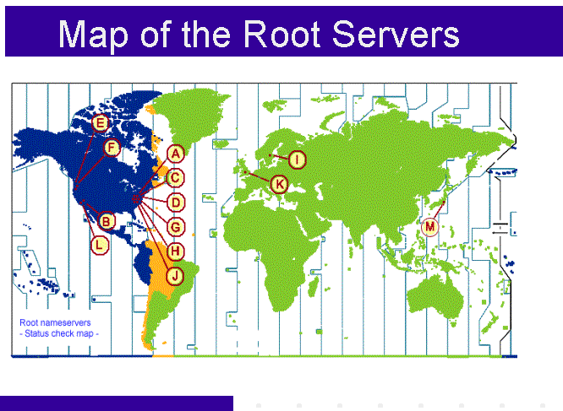
ICANN
from: http://www.icann.org/en/news/correspondence/roberts-testimony-14feb01-en.htm

Slide 12
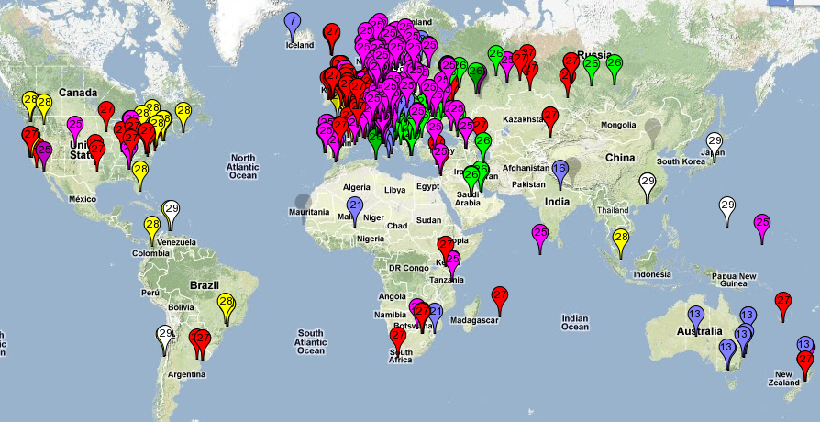
Map of the Roots
k-root (Europe) is an anycast root node
This is RIPE’s map of probing which of the 6 k-root copies get accessed
from https://labs.ripe.net/Members/kistel/dns-measurements-with-ripe-atlas-data

Slide 13
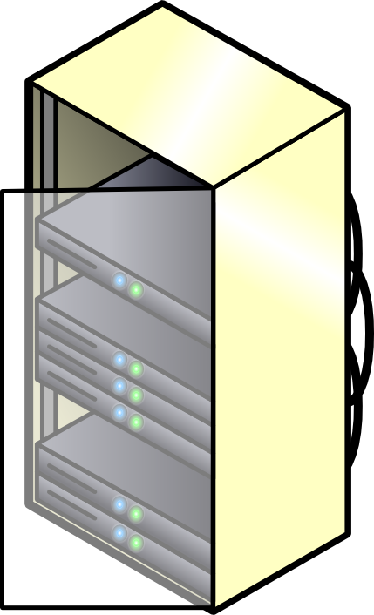


Recursive DNS Query
Classical approach
Must keep state for every request in a server until answered
Allows every node along the path to cache results
Concentrates the data flow at the central servers
Keeps a lot of state on central servers
k.root-server.net
com
huldra.uio.no
ns1.google.com
get www.google.com
www.google.com

Slide 14
Iterated DNS Query
Newer approach
Redirects request
Keep state only at local server (or some servers) until answered
Allows few nodes to cache results
Halves number of requests at central servers
Avoids state on central servers entirely
k.root-server.net
com
huldra.uio.no
ns1.google.com
get www.google.com
www.google.com

Slide 15
Caching vs. Freshness
Caching reduces DNS resolution latency
Caching reduces server load
Caching delays updates
lookup
mpg.ndlab.net
Cached Root Zone File
Cached .com Zone File
Cached .net Zone File
Etc.
ns.ifi.uio.no
Root
net
Information is cached between 5 minutes and 72 hours
update
mpg.ndlab.net
domainnameshop.com
Notes:
CORRECT THIS !!!!!!

Slide 16
DNS as Indirection Service
DNS gives us very powerful capabilities
  Not only easier for humans to reference machines!
Changing the IPs of machines becomes trivial
  e.g. you want to move your web server to a new host
  Just change the DNS record!
  Dynamic DNS
  Zoned DNS

Slide 17
Aliasing and Load Balancing
One machine can have many aliases
mpg.ndlab.net
drammen.ndlab.net
records.sigmm.org
simula080.simula.no
One name can map to multiple machines
www.google.com
That includes k.root-server.net
and
login.ifi.uio.no

Slide 18


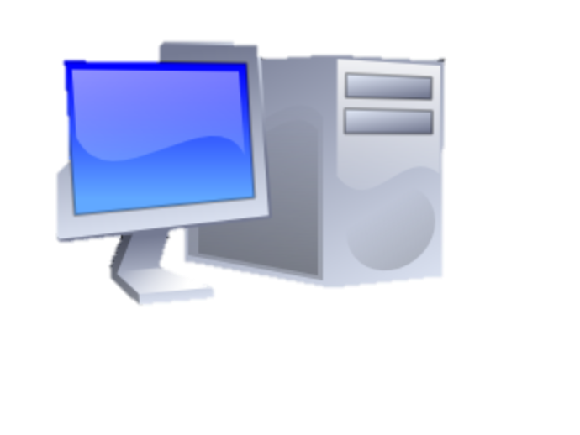
Content Delivery Networks
DNS allows zoning
e.g. Netflix (and Google) addresses depend
on the origin of your connection
geography, ISP, ...
addresses can also depend on server load
minimal 5-minutes allows Netflix
to direct people to other servers every 5 minutes

Slide 19
Content Delivery Networks
DNS allows zoning
e.g. Netflix (and Google) addresses depend
on the origin of your connection
geography, ISP, ...
“Small problem” with this technique
modern to use external resolvers
e.g. ALL Chrome DNS lookups seem to originate from 8.8.8.8
(an address owned by Google)
Consequences
user stays more anonymous
Netflix and others make wrong decisions
addresses can also depend on server load
minimal 5-minutes allows Netflix
to direct people to other servers every 5 minutes

Slide 20
DNS Record
hostname
admin email
record serial number
refresh time
retry time
expiry time
min TTL
start of authority record
@ IN SOA rh7login.ifi.uio.no. hostmaster.ifi.uio.no. 201703291 1800 900 960000 86400
@ NS nn.uninett.no.
@ NS ns1.uio.no.
@ NS ifi.uio.no.
@ A 129.240.65.60
@ A 129.240.65.61
@ A 129.240.65.62
@ A 129.240.65.63
@ MX 50 smtp.uio.no.
login.ifi.uio.no CNAME rh7login.ifi.uio.no
CNAME: an alias (another name)
A: an IPv4 address, several means the name has multiple interfaces, perhaps hosts, AAAA for IPv6
NS: a responsible
name server
MX: mail server’s name
Notes:
2017030312 – serial number by date
refresh time – when to refresh this zone file – 1800sec = 30min
retry time (time to wait after zone file fetch failure) – 1800sec = 15min
expiration time – when does this zone file expire (many failures) – 960 000sec = 11.11 days
min TTL (lifetime of the records in this zone file) – 86 400sec = 24 hours
CNAME: canonical name (an alias)

Slide 21
mDNS
A way of discovering services by announcing them with IP multicast
RFC 6762 (2013): multicast DNS
records announce services (as well as link-local hostnames that are invisible outside the current multicast domain, like mymac.local)
records are never authoritative and mDNS can never redirect or recurse
name of the service
domain where the service is located
priority
port
name of the server
protocol
weight
_service._protocol.example.com SRV 10 0 5060 service.example.com
Example from my machine:
_ssh._tcp.example.com SRV 10 0 22 1x-193-157-212-9.uio.no

