Slide 1
Addressing in the TCP/IP model
IN2140:
Introduction to Operating Systems and Data Communication
Layer 3 Addressing:
IPv6 addresses
Notes:
Vi snakket om L3 adresser, altså IP adresser, allerede i den forrige forelesningen.
Men da begrenset vi oss til IPv4 adresser, som verden egentlig har gått tomt for. Vi rakk ikke å snakke om IPv6, og dette skal vi ta nå.
Egentlig er IPv6 bare enklere strukturert enn IPv4, og derfor tar det ikke så veldig lang tid.
Men må går først tilbake til sentrale IPv4-ideer som også gjelder i IPv6.

Slide 2
CIDR: Classless InterDomain Routing
Idea
  local decision for subdividing host share
  into network portion and end system portion
20
16
B
10
e.g. address
129.8.7.2:
1
0
Network
Host
To write down subnet address
with netmask use either
129.8.4.0/255.255.252.0
or
129.8.4.0/22
1
&
0
0
0
0
0
0
1
0
0
0
0
1
0
0
0
0
0
0
0
0
1
1
&
1
0
0
0
0
0
0
1
0
netmask:
1
1
1
1
1
1
1
1
1
1
1
1
1
1
1
1
1
1
1
1
1
1
0
0
0
0
0
0
0
0
0
0
net address:
1
0
0
0
0
0
0
1
0
0
0
0
1
0
0
0
0
0
0
0
0
1
0
0
0
0
0
0
0
0
0
0
Use “netmask” to distinguish network part from host part
Routing with 3 levels of hierarchy
  end system: compute “dst addr & netmask == subnet addr”
    TRUE: packet to local end system (perhaps ARP, then deliver packet)
    FALSE: packet to another network (send to this network’s router)
  router: compute “dst addr & netmask == subnet addr”
    TRUE: packet to local end system (perhaps ARP, then deliver packet)
    FALSE: packet to another network (look up in routing table, send to other router)
Notes:
Først kommer nettmaskene. Det finnes bare et stort navnerom for L3 addresse (vel, et rom for IPv4 og et from for IPv6).
Siden vi har gått tomt for IPv4 adresser bruker vi tricks som NAT – network address translation – for å leve uten IPv6 i noen år til, men prinsipielt skal man kunne finne maskiner entydig med bare deres IP adresse.

Slide 3
CIDR: Classless InterDomain Routing
Rule of the longest match
  if several entries with different subnet mask length may match
  then use the one with the longest mask
000010xx
11111100
00000xxx
11111000
194.24.0.0/21
Router B
194.24.8.0/22
Router C
194.24.0.0/19
Router A
Unassigned 194.24.12.0/22
1100001000011000
000xxxxx
11100000
xxxxxxxx
194.24.16.0/20
Router D
1111111111111111
00000000
0001xxxx
11110000
000011xx
11111100
Notes:
19: de siste 13 bittene er reservert for adresser som kan ligge innenfor nettet

Slide 4
CIDR: Classless InterDomain Routing
Rule of the longest match
  if several entries with different subnet mask length may match
  then use the one with the longest mask
000010xx
11111100
00000xxx
11111000
194.24.0.0/21
Router B
194.24.8.0/22
Router C
194.24.0.0/19
Router A
Unassigned 194.24.12.0/22
1100001000011000
000xxxxx
11100000
xxxxxxxx
194.24.16.0/20
Router D
1111111111111111
00000000
&: fit
0001xxxx
11110000
000011xx
11111100
&: fail
Route this address:
194.24.6.12
&: fail
&: fit
&: fail
00000110
Notes:
de første 16 bittene må være identiske – alle 5 masker har flere enn 16 bit i starten satt til 1
de siste 8 bittene spiller ikke noen rolle for rutingen – ingen av de 5 maskene har mindre enn 24 bit I starten satt til 1
dette gjør eksempelet vårt enkel: vi må bare se på byte 3 og de bittene i byte 3 som gjelder

Slide 5
CIDR: Classless InterDomain Routing
Rule of the longest match
  if several entries with different subnet mask length may match
  then use the one with the longest mask
000010xx
11111100
00000xxx
11111000
194.24.0.0/21
Router B
194.24.8.0/22
Router C
194.24.0.0/19
Router A
Unassigned 194.24.12.0/22
1100001000011000
000xxxxx
11100000
xxxxxxxx
194.24.16.0/20
Router D
1111111111111111
00000000
&: fail
0001xxxx
11110000
000011xx
11111100
&: fit
Route this address:
194.24.10.12
&: fail
&: fit
&: fail
00001010

Slide 6
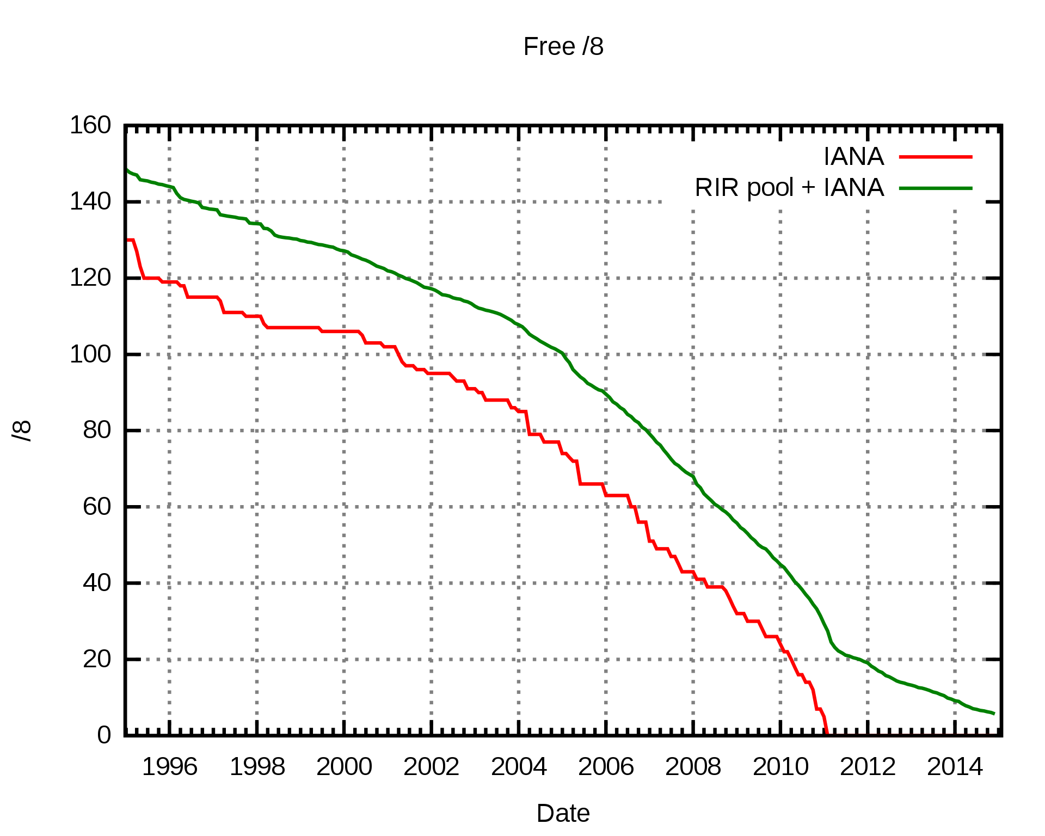
IP Version 6 (IPv6)
Motivation for IPv6: problems with IPv4
  Too few addresses
  Bad support for QoS
  Bad support for mobility
  Many other shortcomings …
IANA: Internet assigned numbers authority
RIR: regional Internet registry
Example consequences:
no IP addresses for individuals
large-scale sharing of Internet addresses in local networks using NAT
Microsoft using addresses from RIR LACNIC (Latin America & Caribbean NIC) for Cloud nodes in North America
[by Mro, CC BY-SA 4.0, https://commons.wikimedia.org/w/index.php?curid=10593349]
Notes:
By Mro - Own work, CC BY-SA 4.0, https://commons.wikimedia.org/w/index.php?curid=10593349
LACNIC: Latin America and Caribbean Network Information Centre

Slide 7
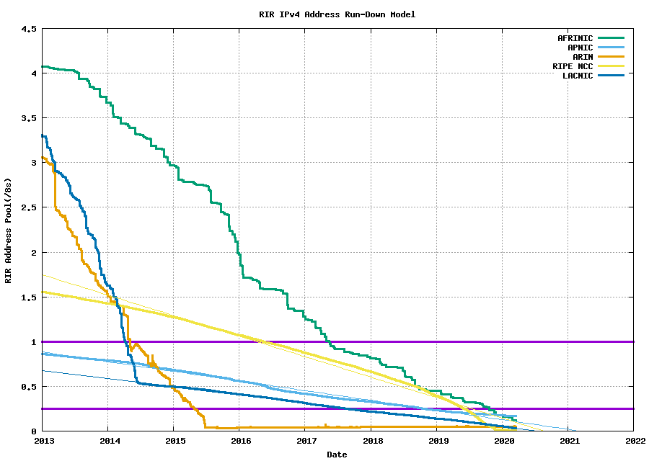
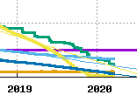
IP Version 6 (IPv6)
Motivation for IPv6: problems with IPv4
  Too few addresses
  Bad support for QoS
  Bad support for mobility
  Many other shortcomings …
Latin America & Caribia
Africa
Asia-Pacific
North America
Europe
from the Blog potaroo.net by Geoff Huston, Chief Scientist at APNIC
Notes:
From the blog of Geoff Huston, Chief Scientist at APNIC
Data from APNIC

Slide 8
IPv6 Objectives
To support billions of end systems
  longer addresses
To reduce routing tables
To simplify protocol processing
  simplified header
To increase security
  security integrated
To support real-time data traffic
  flow label, traffic class
To provide multicasting
To support mobility (roaming)
To be open for change (future)
  extension headers
To coexist with existing protocols
Scalability
Addressing IPv4
limitations
Coexistance

Slide 9
IPv4 and IPv6
shown as 32 bits per line
Version
IHL
DSCP
Type of service
Total length
ECN
Identification
D
M
Fragment offset
Time to live
Protocol
Header checksum
Source address (32 bit)
IPv4 Header
Destination Address (32 bit)
Options (0 or more)
L4 Data
shown as 32 bits per line
New IPv6 header
is larger but simpler
Version
DSCP
ECN
Flow label
Payload length
Next header
Hop Limit
Source address
(128 bit)
IPv6 Header
packet can never be fragmented, now an L4 task
options are now payload (data)
checksum is now an L2/L4 task
Destination Address
(128 bit)
L4 Data
Notes:
IPv6 header: 40 bytes, IPv4 header: from 20 bytes up to 60 bytes
total length in bytes: 16 bit -> 1 opphøyd i 16, 65536, much bigger than packets today
større pakker er mulig (jumbograms) – mulig ved bruk av en extension header – sett payload len til 0 og bruk opsjonen
Header checksum
L2 and L4 have sufficient mechanisms
Communication channels better nowadays, at the expense of the performance

Slide 10
IPv6 addresses
example of the IPv6 address spaces
shown as 64 bits per line
network prefix
subnet identifier
interface identifier
a typical routed address
00101010000000000001010001010000010000000000111100001000000010100000000000000000000000000000000000000000000000000010000000000100
a bit more compact:
2a00:1450:400f:080a:0000:0000:0000:2004
This is an address for www.google.com
2
a
0
0
:
1
4
5
0
:
4
0
0
f
:
0
8
0
a
:
:
:
:
0
0
0
0
0
0
0
0
0
0
0
0
2
0
0
4
Notes:
QUESTION: It is forbidden to write the address with 2 or more sets of compressed zeroes. Why?

Slide 11
IPv6 addresses
example of the IPv6 address spaces
shown as 64 bits per line
network prefix
subnet identifier
interface identifier
a typical routed address
IPv6 addresses are written in sets of 2 bytes in hexadecimal notation
2a00:1450:400f:080a:0000:0000:0000:2004
sets of zero can be compressed:
2a00:1450:400f:80a::2004
this address is part of the network
2a00:1450:400f::/48
which is known to be used by Google since 12/2018
So, its netmask has 48 1-bits followed by 80 0-bits
Notes:
QUESTION: It is forbidden to write the address with 2 or more sets of compressed zeroes. Why?

Slide 12
IPv6 addresses
example of the IPv6 address spaces
shown as 64 bits per line
network prefix
subnet identifier
interface identifier
a typical routed address
Acquiring IPv6 addresses for mobile computers
getting a non-routable IPv6 address using auto-configuration
  self-assigns an IPv6 address consisting of prefix prefix FE80::0 followed by the interface identifier (RFC4291), which is created from the MAC address (RFC 8064)
  before using the address, “Neighbour Solicitation” ICMP message must be sent to ensure the address is not in use yet (RFC4443) – variation of ARP Probe
DHCPv6 to ask for a routable address
  requires auto-configured local address first
Mobile IPv6 to transfer routable home address to visited network
  requires auto-configured local address first

Slide 13
IPv6 addresses
example of the IPv6 address spaces
shown as 64 bits per line
1
1
1
1
1
1
1
0
1
0
all zeroes
interface identifier
a link-local address
Acquiring IPv6 addresses for mobile computers
example IPv6 address of jordin.ifi.uio.no:
fe80::250:56ff:fe80:3f82
which is an abbreviation for
fe80:0000:0000:0000:0250:56ff:fe80:3f82
for us, so far mostly worthless because UiO does not route IPv6 anyway

Slide 14
Addressing in the TCP/IP model
IN2140:
Introduction to Operating Systems and Data Communication
Layer 3 Addressing:
IPv6 addresses

