Slide 1
Analysis of powder neutron diffraction data
The Rietveld method
Examples
MENA3100 – February 27 2017
Magnus H. Sørby

Slide 2

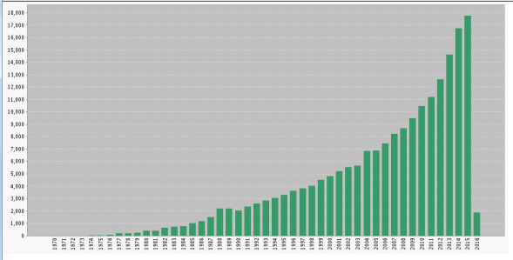
Analysis of powder (neutron) powder diffraction data.
The Rietveld method
Introduced by Hugo Rietveld in 1967
H. M. Rietveld, Acta Cryst. 22 (1967) 151
H. M. Rietveld, J. App. Cryst. 2 (1969) 65
Revolutionized analysis of powder diffraction data. Cited times 11818. (10915 times 1 year ago)
Developed as a technique for structure refinement.

Slide 3
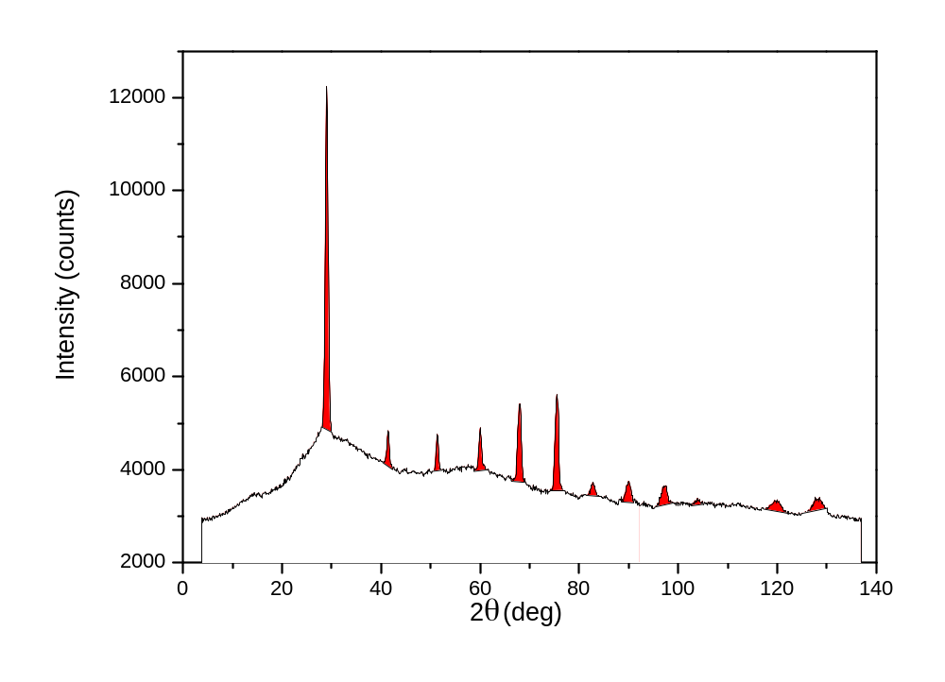
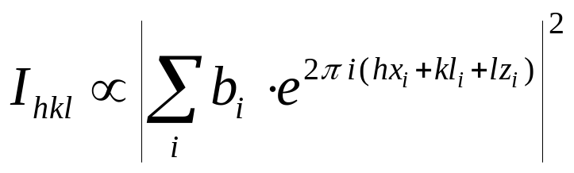
The Rietveld method
Developed as a technique for structure refinement.
The pre-Rietveld life
VD_{0.8}
a = 3.16 Å
hkl | Intensity
110 | 1000
200 | 82
211 | 80
220 | 120
310 | 285
.... | ....

Slide 4
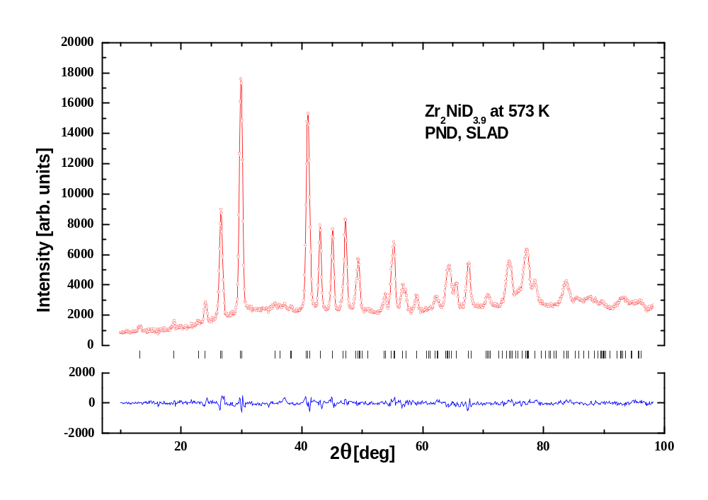
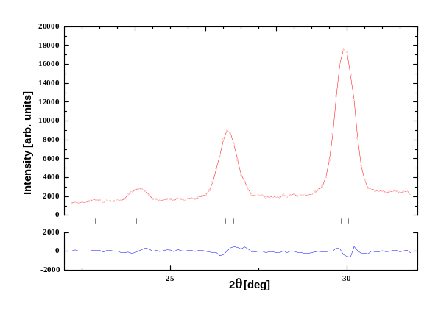
The Rietveld method
Developed as a technique for structure refinement.
The pre-Rietveld life
Zr₂NiD_{4.5} (300 ºC)
a = 6.79 Å
c = 5.61 Å
022/130
112/220
hkl | Intensity
101 | 23
110 | 34
002 | 10
121 | 120
112+220 | 450
022+130 | 1000
002
121

Slide 5
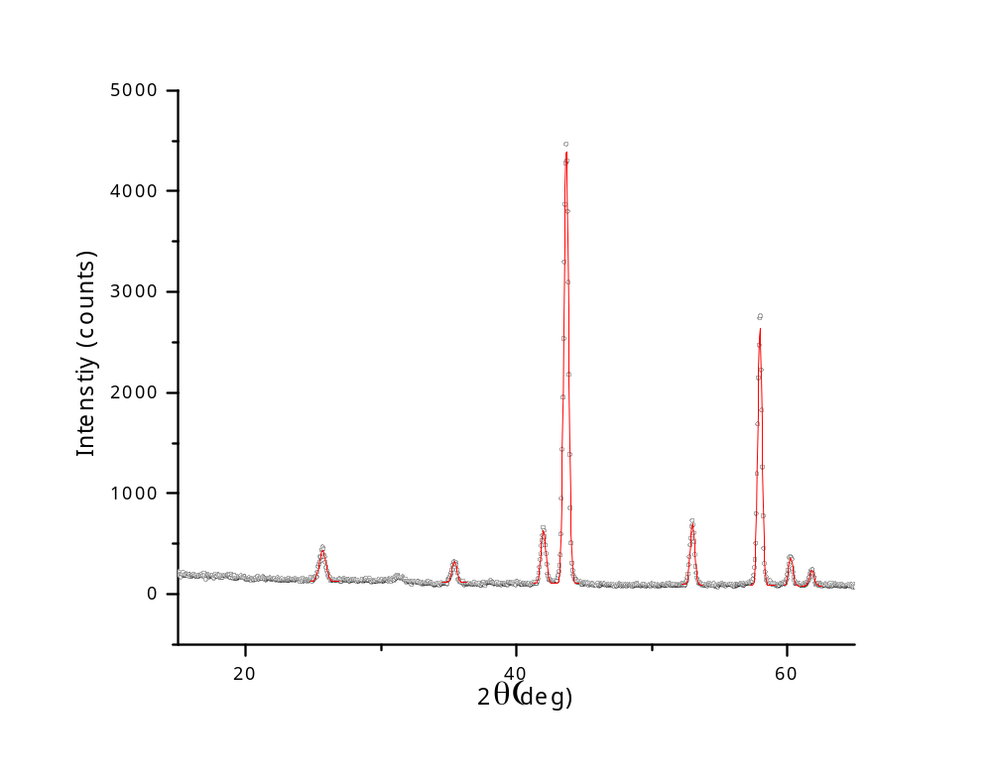
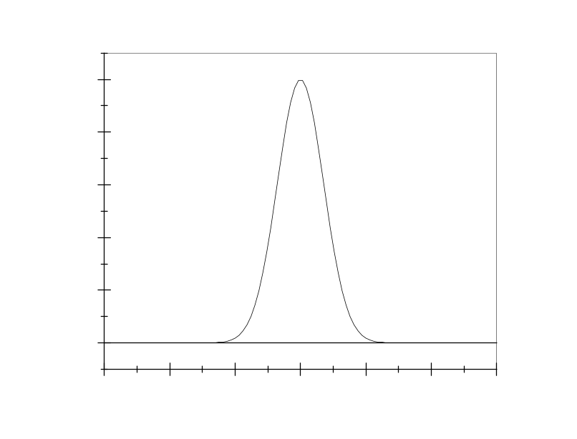

The Rietveld method
Rietveld’s observations:
Well-resolved Bragg- peaks in his PND data had the shape of Gaussian curves.
$$y=e^{−x^{2}}$$
The Gaussian curve

Slide 6
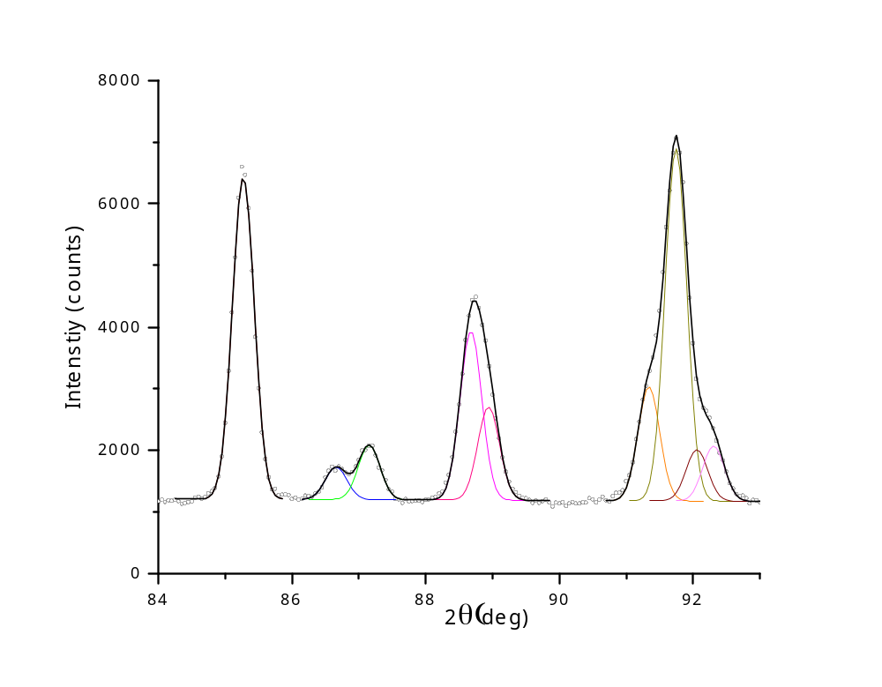
The Rietveld method
Rietveld’s observations:
Well-resolved Bragg- peaks in his PND data had the shape of Gaussian curves.
$$y=e^{−x^{2}}$$
The Gaussian curve

Slide 7
The Rietveld method
Developed as a technique for structure refinement.
Rietveld’s idea:
Why not fit the entire calculated profile from the model to the data, instead of just the integrated intensities?
Zr₂NiD_{4.5} (300 ºC)
a = 6.79 Å
c = 5.61 Å
022/130
112/220
002
121

Slide 8
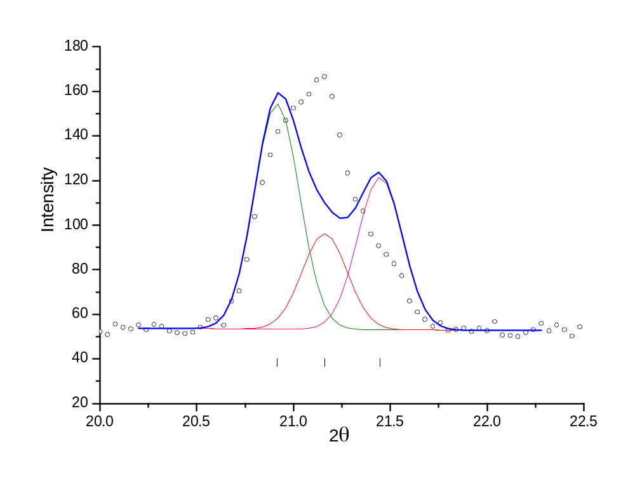
The Rietveld method

Slide 9
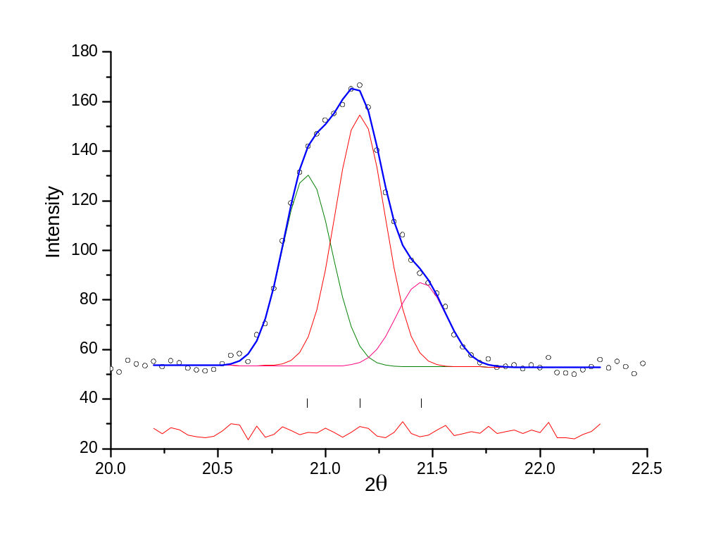
The Rietveld method

Slide 10
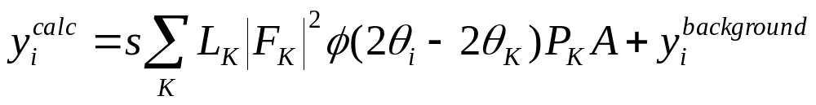
The Rietveld method
The calculated profile
calculated intensity in point i

Slide 11
The Rietveld method
The calculated profile
scale factor
calculated intensity in point i

Slide 12
The Rietveld method
The calculated profile
scale factor
Sum over all Bragg peaks, K, that contribute with intensity to point i
calculated intensity in point i

Slide 13
The Rietveld method
The calculated profile
Lorentz factor and multiplicity
= 1/(sinθ sin2θ) for powders
scale factor
Sum over all Bragg peaks, K, that contribute with intensity to point i
calculated intensity in point i

Slide 14
The Rietveld method
The calculated profile
Lorentz factor and multiplicity
scale factor
Sum over all Bragg peaks, K, that contribute with intensity to point i
calculated intensity in point i
The square modulus of the structure factor for Bragg peak K

Slide 15
The Rietveld method
The calculated profile
Lorentz factor and multiplicity
The profile function
scale factor
Sum over all Bragg peaks, K, that contribute with intensity to point i
calculated intensity in point i
The square modulus of the structure factor for Bragg peak K

Slide 16
The Rietveld method
The calculated profile
Lorentz factor and multiplicity
The profile function
scale factor
Sum over all Bragg peaks, K, that contribute with intensity to point i
preferred orientation
calculated intensity in point i
The square modulus of the structure factor for Bragg peak K

Slide 17
The Rietveld method
The calculated profile
Lorentz factor and multiplicity
The profile function
scale factor
absorption
Sum over all Bragg peaks, K, that contribute with intensity to point i
preferred orientation
calculated intensity in point i
The square modulus of the structure factor for Bragg peak K

Slide 18
The Rietveld method
The calculated profile
Lorentz factor and multiplicity
The profile function
scale factor
absorption
Sum over all Bragg peaks, K, that contribute with intensity to point i
preferred orientation
background
calculated intensity in point i
The square modulus of the structure factor for Bragg peak K

Slide 19
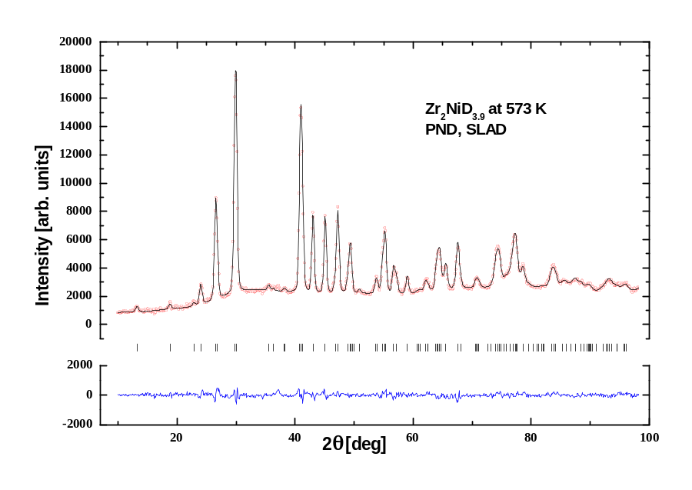
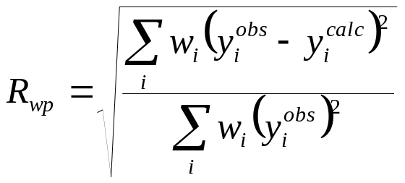
The Rietveld method
Fitting the profile
The parameters in y_{i}^{calc} undergo a least-square refinement to minimize R_{wp}

Slide 20
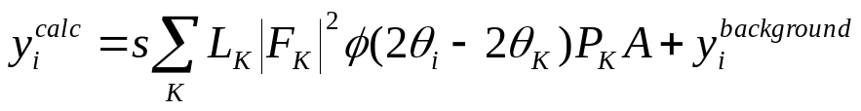
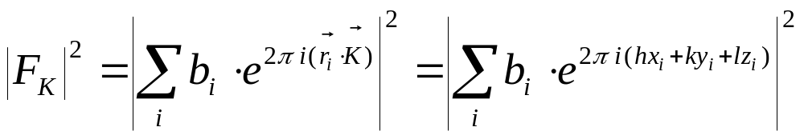
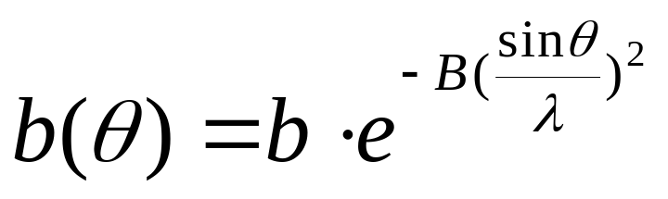
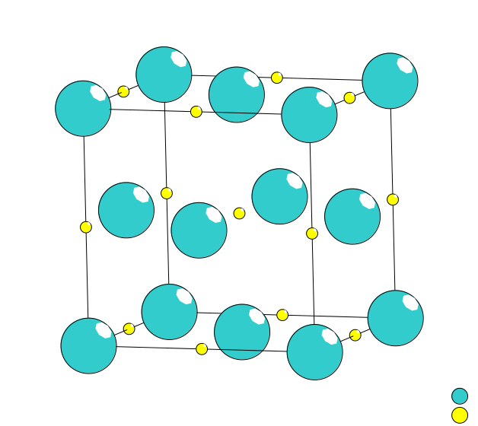

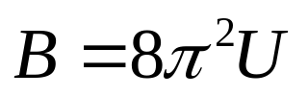
The Rietveld method – structure refinement
The structure factor
The displacement factor
The square mean shift of the atom from its equilibrium position.

Slide 21
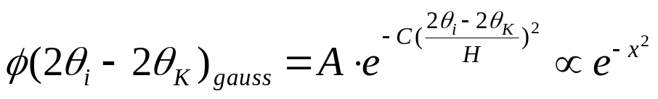
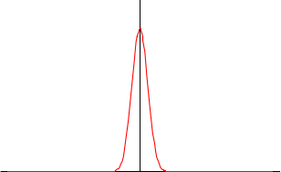
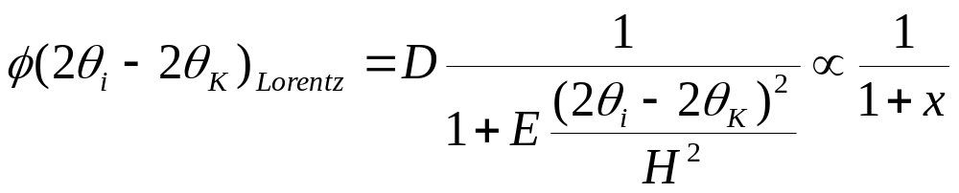
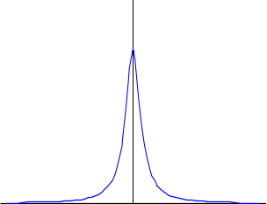
The Rietveld method – structure refinement
The profile function
Gaussian:
Lorentzian:
pseudo-Voigt:

Slide 22
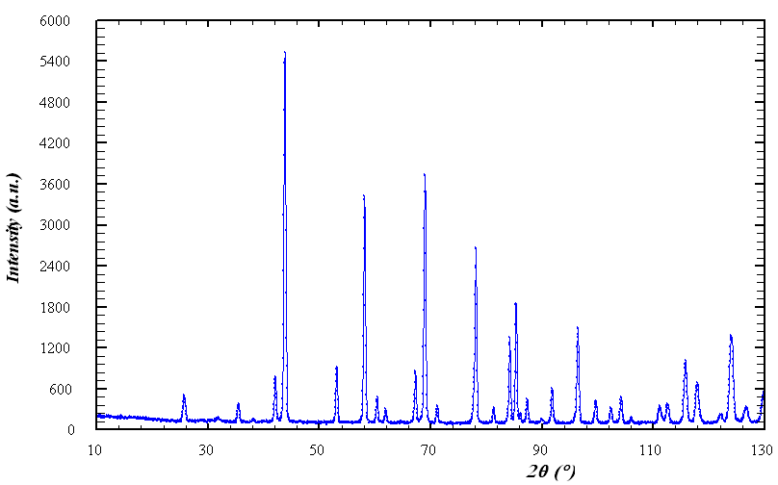
The Rietveld method – structure refinement
An example
PND (PUS)
Approximate model of Al₂O₃:
  Trigonal, space group R –3 c
  a ~ 4.75 Å, c ~ 12.99 Å
  Al in 0 0 ~0.35
  O in ~0.30 0 ¼
We want a more accurate structure model!

Slide 23
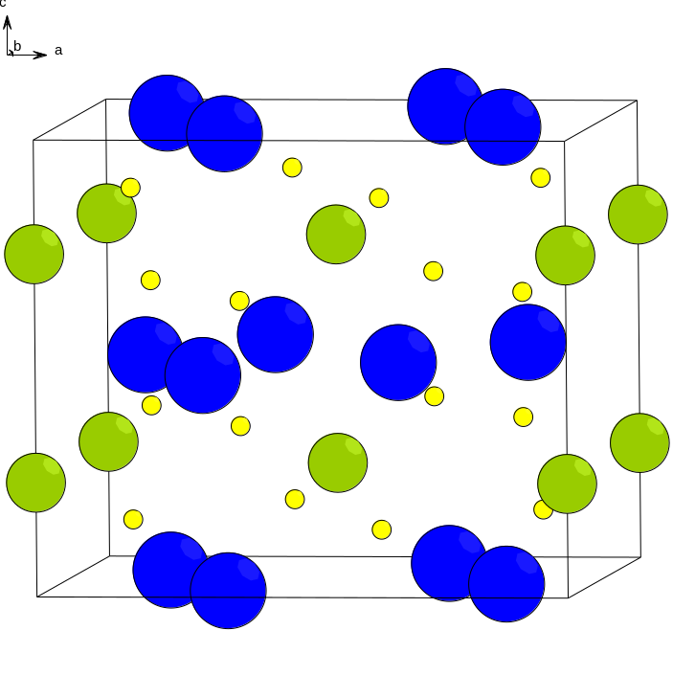
Case: Th₂AlD₄
Very few metal hydrides with H-H distances below
2 Å are reported in the literature.
Th₂AlD₄ is a rare exception.

Slide 24
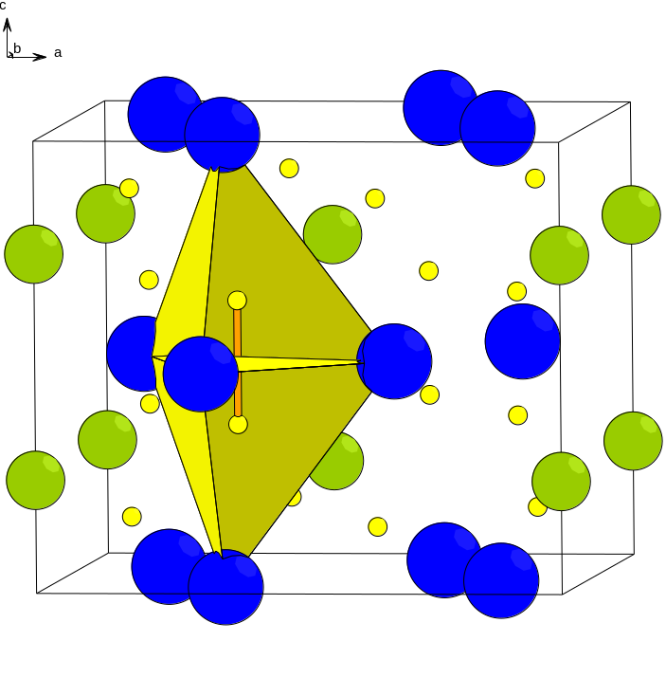
Case: Th₂AlD₄
Very few metal hydrides with H-H distances below
2 Å are reported in the literature.
Th₂AlD₄ is a rare exception.
Structure data (Bergsma et al. 1961)
a = 7.629 Å c = 6.517 Å s.g. I4/mcm
Th: 0.162 0.662 0
Al: 0 0 ¼
D: 0.368 0.868 0.137
D-D = 2*z(D)*c
1.79 Å

Slide 25
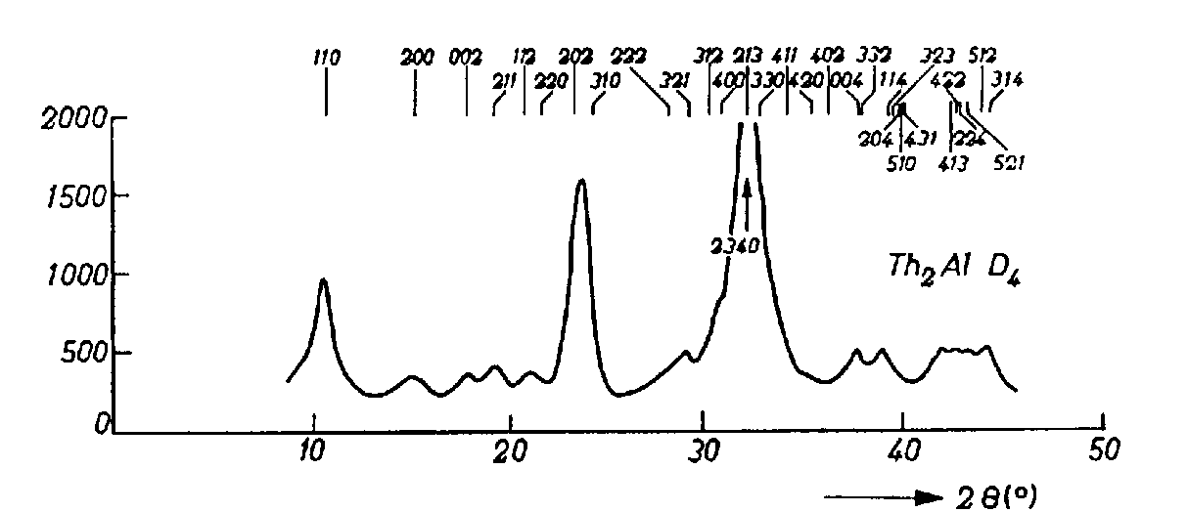
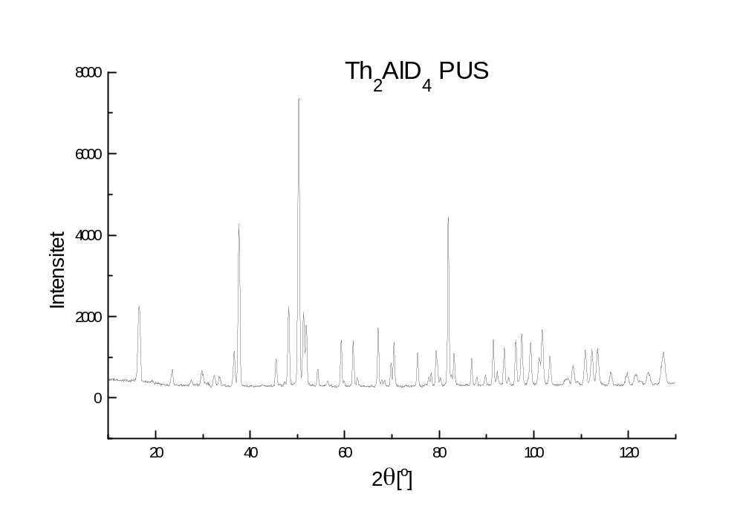
Case: Th₂AlD₄
PND anno 1961
PND today

Slide 26
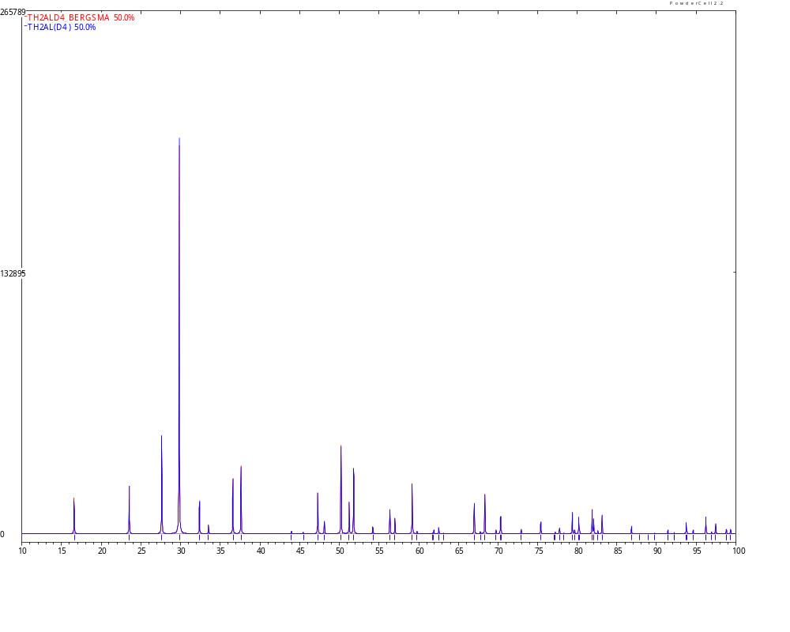
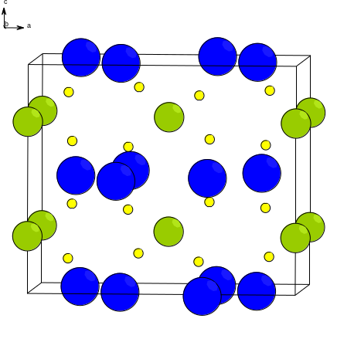

Case: Th₂AlD₄
X-ray diffraction

Slide 27
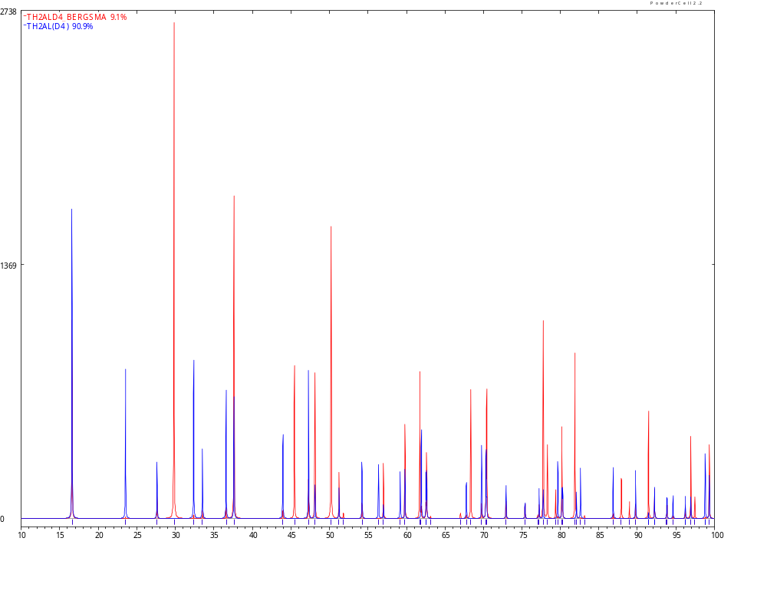
Case: Th₂AlD₄
Neutron diffraction

Slide 28
Conclusion
Rietveld refinement is an effective technique to refine crystal structure models against powder diffraction data.
It can also be used for quantitative phase analysis and to extract microstructural information.
The instrumental development has been great for the last decades.

