Slide 1
HUMR5502 - Autumn 2013: Ethnic Challenges to the Nation State: Studying State Responses from a Human Rights Perspective
The case of China

Slide 2
ethnicity and the state
who has the right to be registered in the Sami census (samemanntallet)?
  declare to consider oneself as Sami, and
    use Sami language, or have a parent, grand parent or great grand parent, and/or
    be the child of a person who is registered in the Sami census
objective and subjective criteria! 12,500 registered, 50 to 65,000 can qualify

Slide 3
concepts of ethnic group/ ethnic identity/ ethnicity
primordialist view: biology
  ethnic groups are extended kin groups, collectives based on descent,
  recognition of this is genetically encoded
constructivist view: ethnic identity is
  relational
  contextual
  dynamic

Slide 4
Chinese views
traditional classification’cooked’ (shú 熟) and ’raw’ (shēng 生)
modernity: Republic: ’scientific’ classification:
  race
  language
civilising projects:
  Confucian
  Communist

Slide 5
PRC ethnic classification mínzú shíbié (民族识别 ) project: background
modernist mapping of population:
  consolidating the border regions
  political integration of the territory
conducting land reform/ class struggle
establishing the system of regional autonomy
representation of the ethnic minorities at the National People’s Congress

Slide 6
PRC ethnic classification project: implementation
evolutionary theories of Morgan:
  Primitive hunter gatherer societies
  Slave societies
  Feudal societies
  Capitalism
  Socialism
  Communism
nominally based on criteria used by Stalin:
  common language
  common territory
  common economy
  common psychological make-up manifested in a common culture
... and self definition: 260 applications in Yunnan
in practice: mainly language

Slide 7
PRC ethnic classification project: results
55 minority nationalities (shǎoshù mínzú 少数民族) + 1 Han nationality (Hànzú 汉族) = Chinese nation (Zhōnghuá mínzú 中华民族)
fixed identities in 1964, only 2 extra in 1978
although: many discrepancies
limited contestation, growing internalisation

Slide 8
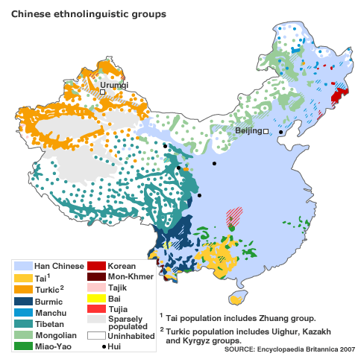
Ethnic minorities in China
56 officially recognised ethnic groups: 55 + 1 (Han-Chinese)
national minorities or minority nationalities shǎoshù mínzú (少数民族) make up 9.44% in 2005, or 110 million people
live on 50% of China’s territory, mainly in western China: scarcely populated and poorly developed
  Xinjiang / East-Turkestan
  Tibet
  Mongolia
  Manchuria
  Southwest China
  many of these minorities have had a history of state formation or other forms of political independence

Slide 9
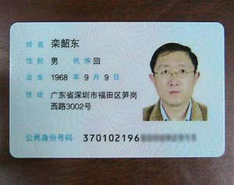
Chinese ID-card
Notes:
Luán Sháodōng

Slide 10
Officially recognised national minorities in China (2000)
Zhuang | 16 178 811 | Lisu | 634 912 | Pumi (Premi) | 33 600
Manchu | 10 682 262 | Gelao | 579 357 | Ewenki | 30 505
Hui (Donggan) | 9 816 805 | Dongxiang | 513 805 | Nu | 28 759
Miao (Hmong) | 8 940 116 | Lahu | 453 705 | Jing | 22 517
Uyghurs | 8 399 393 | Shui | 406 902 | Jinuo | 20 899
Yi | 7 762 272 | Va | 396 610 | De’ang | 17 935
Tujia | 5 725 049 | Naxi | 308 839 | Bonan | 16 505
Mongols | 4 5813 94 | Qiang | 306 072 | Russians | 15 609
Tibetans | 5 416 021 | Tu | 241 198 | Yugur | 13 719
Buyi | 2 971 460 | Mulao | 207 352 | Uzbeks | 12 370
Dong | 2 960 293 | Xibo (Xibe) | 188 824 | Moinba | 8 923
Yao | 2 637 421 | Kyrgyz | 160 823 | Oroqen | 8 196
Koreans | 1 923 842 | Daur | 132 394 | Drung | 7 426
Bai | 1 858 063 | Jingpo (Kachin) | 132 143 | Tatars | 4 890
Hani (Akha) | 1 439 673 | Maonan | 107 166 | Hezhen | 4 640
Kazakhs | 1 250 458 | Salar | 104 503 | Gaoshan | 4 461
Li | 1 247 814 | Blang | 91 882 | Lhoba | 2 965
Dai (Shan) | 1 158 989 | Tajiks | 41 028 | Foreigners (2010) | 608 919
She | 709 592 | Achang | 33 936 | Not classified (1995) | 752 347

Slide 11
nationality | population | speakers of minority language
Mongols | 3,410,000 | 2,747,000
Tibetans (Zang) | 3,870,000 | 3,620,000
Miao | 5,030,800 | 4,000,000
Manchu | 4,299,100 | 0 (only old people in two small villages in Heilongjiang can still understand the language)
Dong | 1,536,500 | 1,180,000 (77%), rest Chinese
Tujia | 2,832,700 | 200,000 (7%)

Slide 12
Law of the People's Republic of China on Regional National Autonomy
The People's Republic of China is a unitary multinational state created jointly by the people of all its nationalities. Regional national autonomy is the basic policy adopted by the Communist Party of China for the solution of the national question in China through its application of Marxism-Leninism;
Article 4 The organs of self-government of national autonomous areas shall exercise the functions and powers of local organs of state[…]. At the same time, they shall exercise the power of autonomy within the limits of their authority as prescribed by the Constitution, by this Law and other laws, and implement the laws and policies of the state in the light of existing local conditions.
Article 7 The organs of self-government of national autonomous areas shall place the interests of the state as a whole above anything else and make positive efforts to fulfil the tasks assigned by state organs at higher levels.

Slide 13
Article 10 The organs of self-government of national autonomous areas shall guarantee the freedom of the nationalities in these areas to use and develop their own spoken and written languages and their freedom to preserve or reform their own folkways and customs.
Article 11 The organs of self-government of national autonomous areas shall guarantee the freedom of religious belief to citizens of the various nationalities. […]
Article 19 The people's congresses of national autonomous areas shall have the power to enact regulations on the exercise of autonomy and separate regulations in the light of the political, economic and cultural characteristics of the nationality or nationalities in the areas concerned. The regulations on the exercise of autonomy and separate regulations of autonomous regions shall be submitted to the Standing Committee of the National People's Congress for approval before they go into effect. […]
Article 20 If a resolution, decision, order or instruction of a state organ at a higher level does not suit the conditions in a national autonomous area, the organ of self-government of the area may either implement it with certain alterations or cease implementing it after reporting to and receiving the approval of the state organ at a higher level.
Notes:
In the RNAL, Article 36 of the Constitution surfaces in the form of Article 11 where the formulation “[t]he state shall protect…” has been replaced with “[t]he autonomous organs of the autonomous areas shall protect…”.

Slide 14
local autonomy regulations, examples
Art. 18 “one cannot reinstate the already abolished feudal system of special privileges and oppression” Autonomy Regulations of Hualong Hui Nationality Autonomous County in Qinghai Province
“Religious activities should not interfere with the administration, the judicature, education, marriage and family planning.”
Notes:
This constitutes the blueprint that is used for the only reference to religion in most of the local autonomy regulations, such as the one for Muli Tibetan Autonomous County where it is found in Article 7, out of a total of 72 articles. In several autonomy regulations religion is mentioned in only one sentence, i.e. not even as a separate article, but as part of an article conferring on the local government the duty to protect the freedom of the minority nationalities in the territory to use their own language and script, their customs and festivals. In the autonomy regulations of Gongcheng Yao Nationality Autonomous County in Guangxi Province, for example, this one line is the last line of Article 60, out of a total of 64 articles; it reads: “The autonomous organs of the autonomous county protect the freedom of religious beliefs of the citizens of every nationality.” Only rarely has the content of Article 36 of the Constitution been expanded. In a few cases a sentence has been added which further specifies restrictions on religious activities: “Religious activities should not interfere with the administration, the judicature, education, marriage and family planning.” Once in a while rather peculiar additions have been made, such as the one in Article 18 of the regulations of Hualong Hui Nationality Autonomous County in Qinghai Province which states that “one cannot reinstate the already abolished feudal system of special privileges and oppression”. Or the rather extensive Article 51 of the regulations of Datong Hui Nationality Autonomous County in the same province which has added a few lines admonishing different religious denominations to respect each other. Such an addition might be related to the long history of conflict between the Muslim Hui and the Buddhist Tibetans in the region.
If nothing else, it can be concluded from surveying the different autonomy regulations that this legal system is not specifically concerned with granting larger freedom to the recognised ethnic minorities than to the Han Chinese majority. It merely delegates the implementation of national law on religion to the local autonomous organs. The rather few discrepancies between national law and local regulation consist of the integration of central policy on religion as it can be found in existing party and government documents. Far from granting minority nationalities more (special) rights, it could be argued that these additions further limit their freedom of religious beliefs by reducing the discretion local authorities might enjoy in implementing a vague and general law.

Slide 15
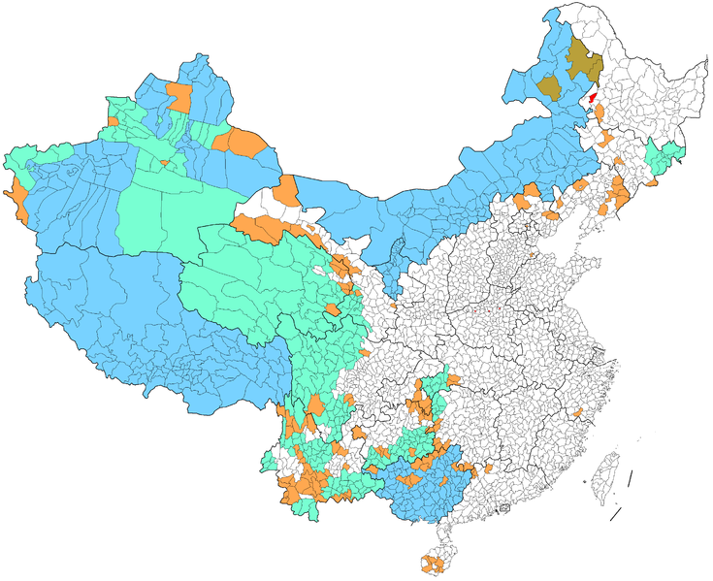
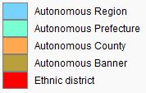
three levels of autonomous areas in the PRC
adapted from Wikipedia
Notes:
5 autonomous regions at province level
30 autonomous prefectures
117 autonomous counties
3 banners
The actual degree of autonomy of such regions is questioned. This is because their authority rests with the Constitution and the Law on Regional Autonomy, requiring leaders to seek prior approval from the National People's Congress (NPC) to pass legislation. This is not true for other provinces, which can pass legislation without such prior approval. For this reason, it has been contended that Autonomous regions are in fact "less autonomous.“
Autonomous regions, prefectures, counties, and banners are covered under Section 6 of Chapter 3 (Articles 111-122) of the Constitution of the People's Republic of China, and with more detail under the Law of the People's Republic of China on Regional National Autonomy (《中华人民共和国民族区域自治法》). The constitution states that the head of government of each autonomous areas must be of the ethnic group as specified by the autonomous area (Tibetan, Uyghur, etc.). The constitution also guarantees a range of rights including: independence of finance, independence of economic planning, independence of arts, science and culture, organization of local police, and use of local language. In addition, the head of government of each autonomous region is known as a "chairman", unlike provinces, where they are known as "governors"

Slide 16
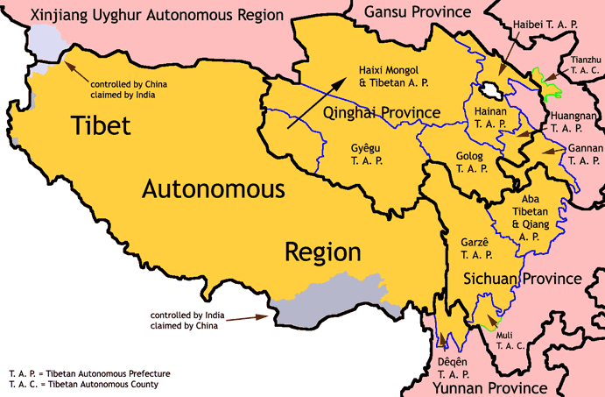
Map from Electionworld, Wikimedia

Slide 17
population in Xinjiang according to nationality

Slide 18
internal colonialism?
ethnic groups were integrated into China through military force
exploitation of resources in ethnic minority areas without benefitting the local population
non-effective autonomy system: Communist Party leadership is dominated by Han Chinese and constitutes the supreme power
policy of population transfers to consolidate ethnic minority areas
growing socio-economic differences between ethnic minorities and Han Chinese
ineffective protection of minority culture
few positive measure: less strict birth control and extra points at entrance examination

Slide 19
(im)possibilities for solving ethnic conflict, accommodating diversity
“harmonious society” ↔ diversity, dissenting
  no legitimate ways of expressing dissatisfaction
  stability at all cost
“scientific development” ↔ minority culture
  “backward” culture
  education
nationalism discourse → Han chauvinism
democratisation???
other models: one country – two systems???

