Slide 1
The Protection of
Human Rights in Europe
Ludovica Chiussi
Doctoral Research Fellow in Public International Law, University of Oslo and Bologna
Visiting Fellow, University of Cambridge
13 September 2017

Slide 2
EUROPE MULTI-LAYERED
HUMAN RIGHTS SYSTEM
▲ Council of Europe (CoE)
Convention for the Protection of Human Rights and Fundamental Freedoms (ECHR), 1949
European Social Charter, 1961
▲ European Union (EU)
Charter of Fundamental Rights, 2000
Fundamental Rights Agency
▲ Organization for Security and Cooperation in Europe (OSCE)
Final Act of Helsinki, 1975
Office for Democratic Institutions in Europe
High Commission of National Minorities

Slide 3
KEY DEVELOPMENTS OF THE COE
5 May 1949: Creation of the Council of Europe;
4 November 1950: Adoption of the ECHR
3 September 1953: Entry into force of the Convention
14 November 1960: The Court delivers its first judgment: Lawless v. Ireland
1 November 1998: Entry into force of Protocol No. 11 to the Convention, instituting “the new Court”
18 September 2008 The Court delivers its 10,000th judgment

Slide 4
Institutional Framework of the CoE
Secretary General: appointed by the Assembly on the recommendations of the Committee of Ministers. It is the depositary of ratifications, reservations and renunciations to the instruments of the CoE.
Committee of Ministers: primary decision-making body of the Council. Composed of the Minister of Foreign Affairs from each member State. It monitors the compliance of States with the ECHR .
Parliamentary Assembly: representative of the people of th CoE sitting in broad political groups.
European Court of Human Rights: the judicial organ monitoring the Convention.

Slide 5
The Convention for the Protection of
Human Rights and Fundamental Freedoms (ECHR)
Adopted on 4 November 1950 and it entered into force on 3 September 1953.
It gave effect to certain of the rights stated in the Universal Declaration of Human Rights and established an international judicial organ with jurisdiction to find against States that do not fulfil their undertakings (ECtHR).
59 Articles, mainly civil and political rights.

Slide 6
What are the Rights Protected by the ECHR?
• the right to life;
• the right to a fair hearing;
• the right to respect for private and family life;
• freedom of expression;
• freedom of thought, conscience and religion;
the protection of property.
The Convention prohibits
torture and inhuman or degrading treatment or punishment;
slavery and forced labour;
death penalty;
arbitrary and unlawful detention
discrimination in the enjoyment of the rights and freedoms set out in the Convention.

Slide 7
The European Court of Human Rights (ECtHR)
Human Rights Court set up by the Council of Europe in 1959 as judicial mechanism to implement the European Convention of Human Rights and Fundamental Freedom
The number of judges on the Court is the same as that of the States Parties to the Convention (47 at present).
Based in Strasbourg, France.
=
Court of Justice of the European Union (Luxembourg)
International Court of Justice (The Hague).

Slide 8
Who are the Claimants and Respondents before the Court?
CLAIMANTS:
Individual complaints (Protocol 11): applications lodged by any person, group of individuals, company or NGO having a complaint about a violation of their rights;
Inter-State complaints (Article 33): applications brought by one State against another.
RESPONDENTS:
One or more States. NO individual, nore other private entitites.

Slide 9
THE PROCEEDINGS BEFORE THE COURT
ADMISSIBILITY (article 35 ECHR): domestic remedies exhausted, complaints not anonymous, manifestly unfounded or abuse of process, complaints raising the same issue as previously decided, presence of a “significant disadvantage”, no more than 6 months after last domestic judgment.
MERITS
APPEAL: Grand Chamber hearings
ENFORCEMENT: Committee of Ministers supervising the implementation of the judgment.

Slide 10
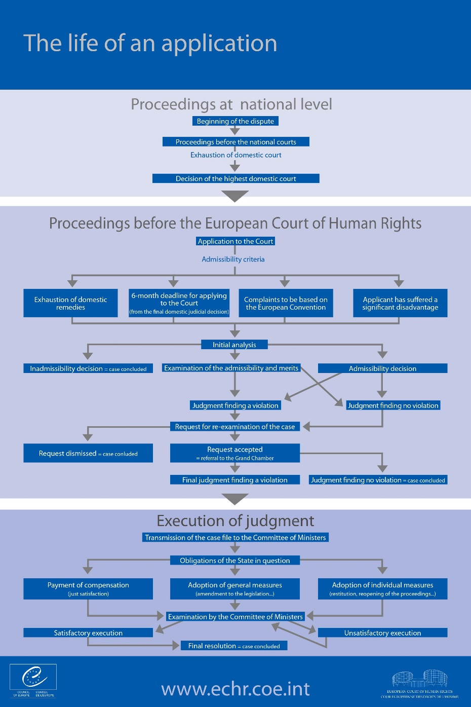

Slide 11
The revised control mechanisms
Protocol No. 11, restructuring the control machinery, adopted on 11 May 1994, entered into force on 1 November 1998
  A sidestep:
    Additional protocols: Do not amend the original text, but introduces additional rights. Do not require consensus; become binding for States that ratify
    Amending protocols: Amend the original text (“Since its entry into force on 1 November 1998, this Protocol forms an integral part of the Convention”). Require consensus, do not enter into force until all Contracting States have consented

Slide 12
Protocol no. 11
A tripartite system
The European Commission on Human Rights
Now established as a permanent body
The European Court of
Human Rights
New, reduced role:
To supervise compliance with decisions by the Court
The Committee
of Ministers
Assumed (most of) the responsibilities of the Commission
The competence of the Court became compulsory
Notes:
Preceded by Protocol No. 9 in 1994, which allowed individuals to bring cases directly to the Court.

Slide 13
A dramatic increase in cases
A victim of its own success?
2010
2011
Attempt at improvement: Protocol No. 14, entry into force 1 June 2010. Aims to guarantee the long-term efficiency of the Court by optimising the filtering and processing of applications
New judicial formations to deal with the simplest cases
A new admissibility criterion (“significant disadvantage”)
Judges’ terms of office to be extended to nine years without the possibility of re-election.
Applications received
61,300
64,500
Applications disposed of
41,183
52,188
Annual deficit
20,100
12,300
Backlog 31 December
139,650
151,600
More than 90 % of cases are declared inadmissible
2010: 38,576
2011: 50,677

Slide 14
2010
2011
2012
2013
Applications received
61,300
64,500
65,150
Applications disposed of
41,183
52,188
87,879
Annual deficit
20,100
12,300
+ 22,700
Backlog 31 December
139,650
151,600
128,100
99,900
More than 90 % of cases are declared inadmissible
2010: 38,576
2012: 86,201
2011: 50,677

Slide 15
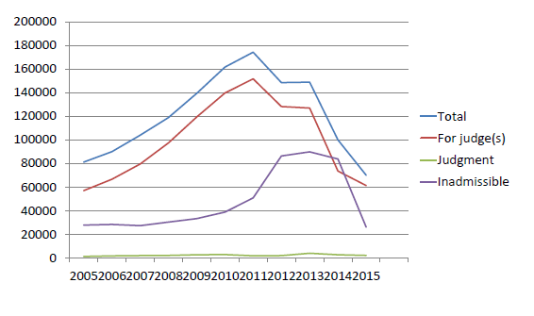

Slide 16
International supervisory mechanisms are secondary to the institutions of national legal systems in adjudicating on claims that human rights have been violated.
The space for manoeuvre that is granted to national authorities in fulfilling their obligations under human rights conventions.
“Affirming that the High Contracting Parties, in accordance with the principle of subsidiarity, have the primary responsibility to secure the rights and freedoms defined in this Convention and the Protocols thereto, and that in doing so they enjoy a margin of appreciation, subject to the supervisory jurisdiction of the European Court of Human Rights established by this Convention,”
Protocol no. 15
Notes:
Since 2010, three high-level conferences on the future of the Court have been convened to identify the means to guarantee the long-term effectiveness of the Convention system. These conferences have, in particular, led to the adoption of Protocols 15 and 16 to the Convention.
Protocol No. 15, adopted in 2013, inserts a reference to the principle of subsidiarity and the doctrine of the margin of appreciation into the Convention’s preamble; it also reduces from 6 to 4 months the time within which an application must be lodged with the Court after a final national decision.
2013 has also seen the adoption of Protocol No. 16, which will allow the highest domestic courts and tribunals to request the Court to give advisory opinions on questions of principle relating to the interpretation or application of the rights and freedoms defined in the Convention or the protocols thereto. Protocol No. 16 is optional.

Slide 17
Fundamental principles of interpretation
The Vienna Convention on the Law of Treaties
A strong principle of effectiveness
A clear evolutive interpretation
The European Court of Human Rights
National courts
«No less, but certainly no more»
For national law to decide
A tendency to apply the same method as the ECtHR
«No more, but certainly no less»
Challenge: The evolutive interpretation

Slide 18
Pilot-judgment procedure
Introduced in 2004 as a means of addressing systemic problems in Contracting States which result in multiple applications to the Court
One (or a few) case is given priority treatment, while other applications are adjourned until the pilot case is decided
Justification:
  Speedier redress for victims
  The systemic problem is redressed within the national legal order under guidance from the Court
  A large number of repetitive cases may be removed from the Court’s docket

Slide 19
Examples of pilot-judgments
Broniowski v. Poland (2004): Failure to compensate loss of property
  See paras. 189-194: The pilot-judgment procedure explained
Burdov v. Russia (2009): Failure to enforce domestic court decisions
Rumpf v. Germany (2010): Length of proceedings

Slide 20
Enforcement
Art. 46
Binding force
«undertake to abide by the final judgment»
Execution of judgments
Committee of Ministers
Referral to Court
Interpretation procedure
Infringement procedure
Notes:
Standard supervision
Enhanced supervision

Slide 21
Asia
ASEAN Intergovernmental Commission on Human Rights, established 2009
Weaker mandate: Develop strategies, enhance public awareness, advisory service. Does not receive individual complaints.
ASEAN Human Rights Declaration 2012
Extensive text, little impact

Slide 22
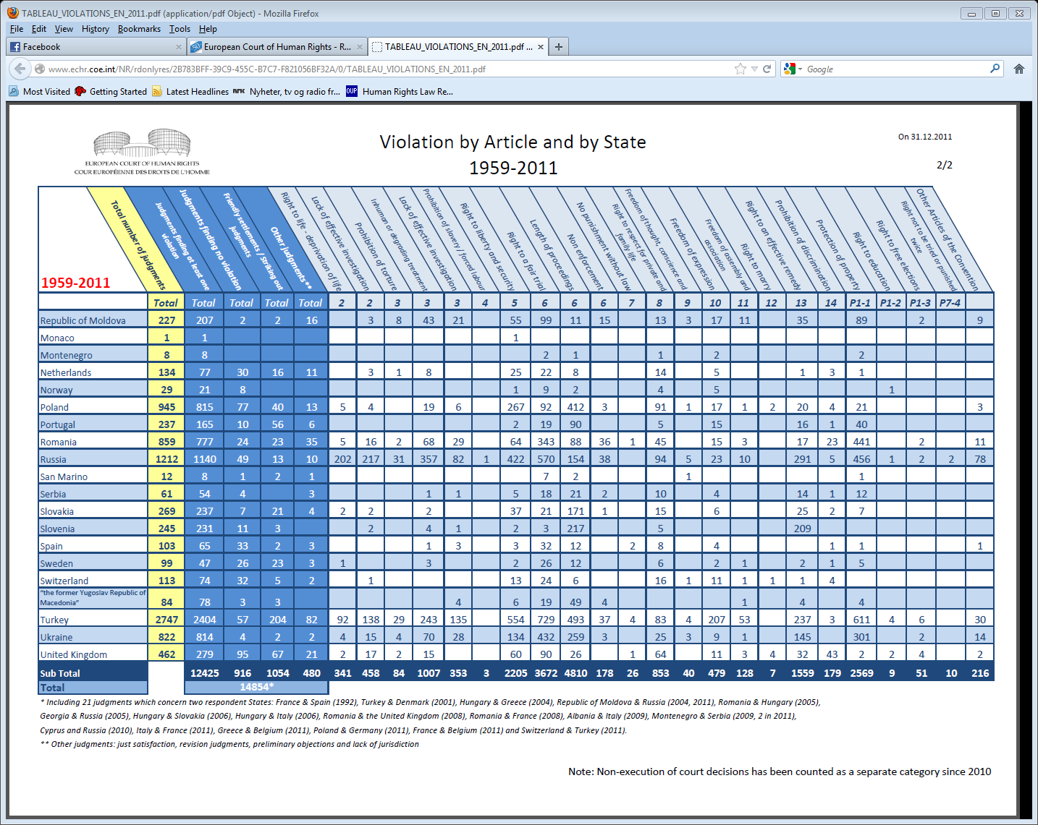
Notes:
No formal hierarchy of norms
A category of fundamental rights?
Vienna Declaration 1993: ”All human rights are universal, indivisible and interdependent and interrelated.”
Integrated interpretation?
ESC Rights as _superior_ or _not rights at all_
Integrated: Limit the negative effects of the separation

Slide 23
Thank you!
ludovica.chiussi@nchr.uio.no

