Slide 1
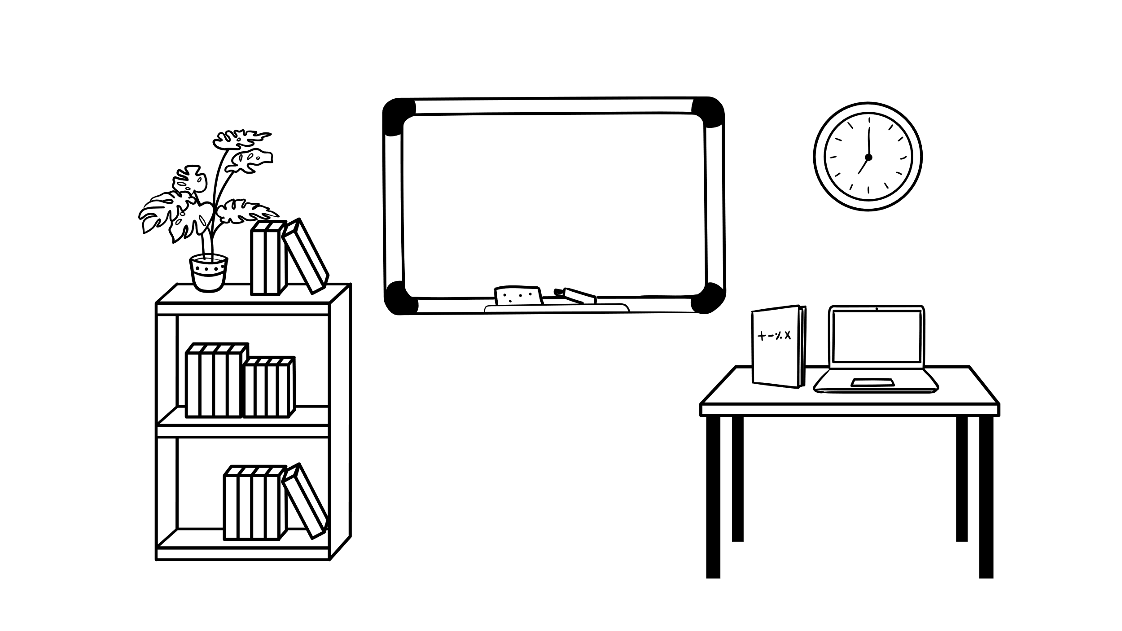
Info meeting for seminar leaders

Slide 2
Go in pairs and ask each other the following …
Which course(s) are you part of this semester?
What do you look forward to in the seminars?
Do you have any concerns or previously experienced challenges from teaching?
…

Slide 3

Bjørn Høyland
Seminar teaching at ISV
It is not about you
Stick to the script
Attend the lectures

Slide 4
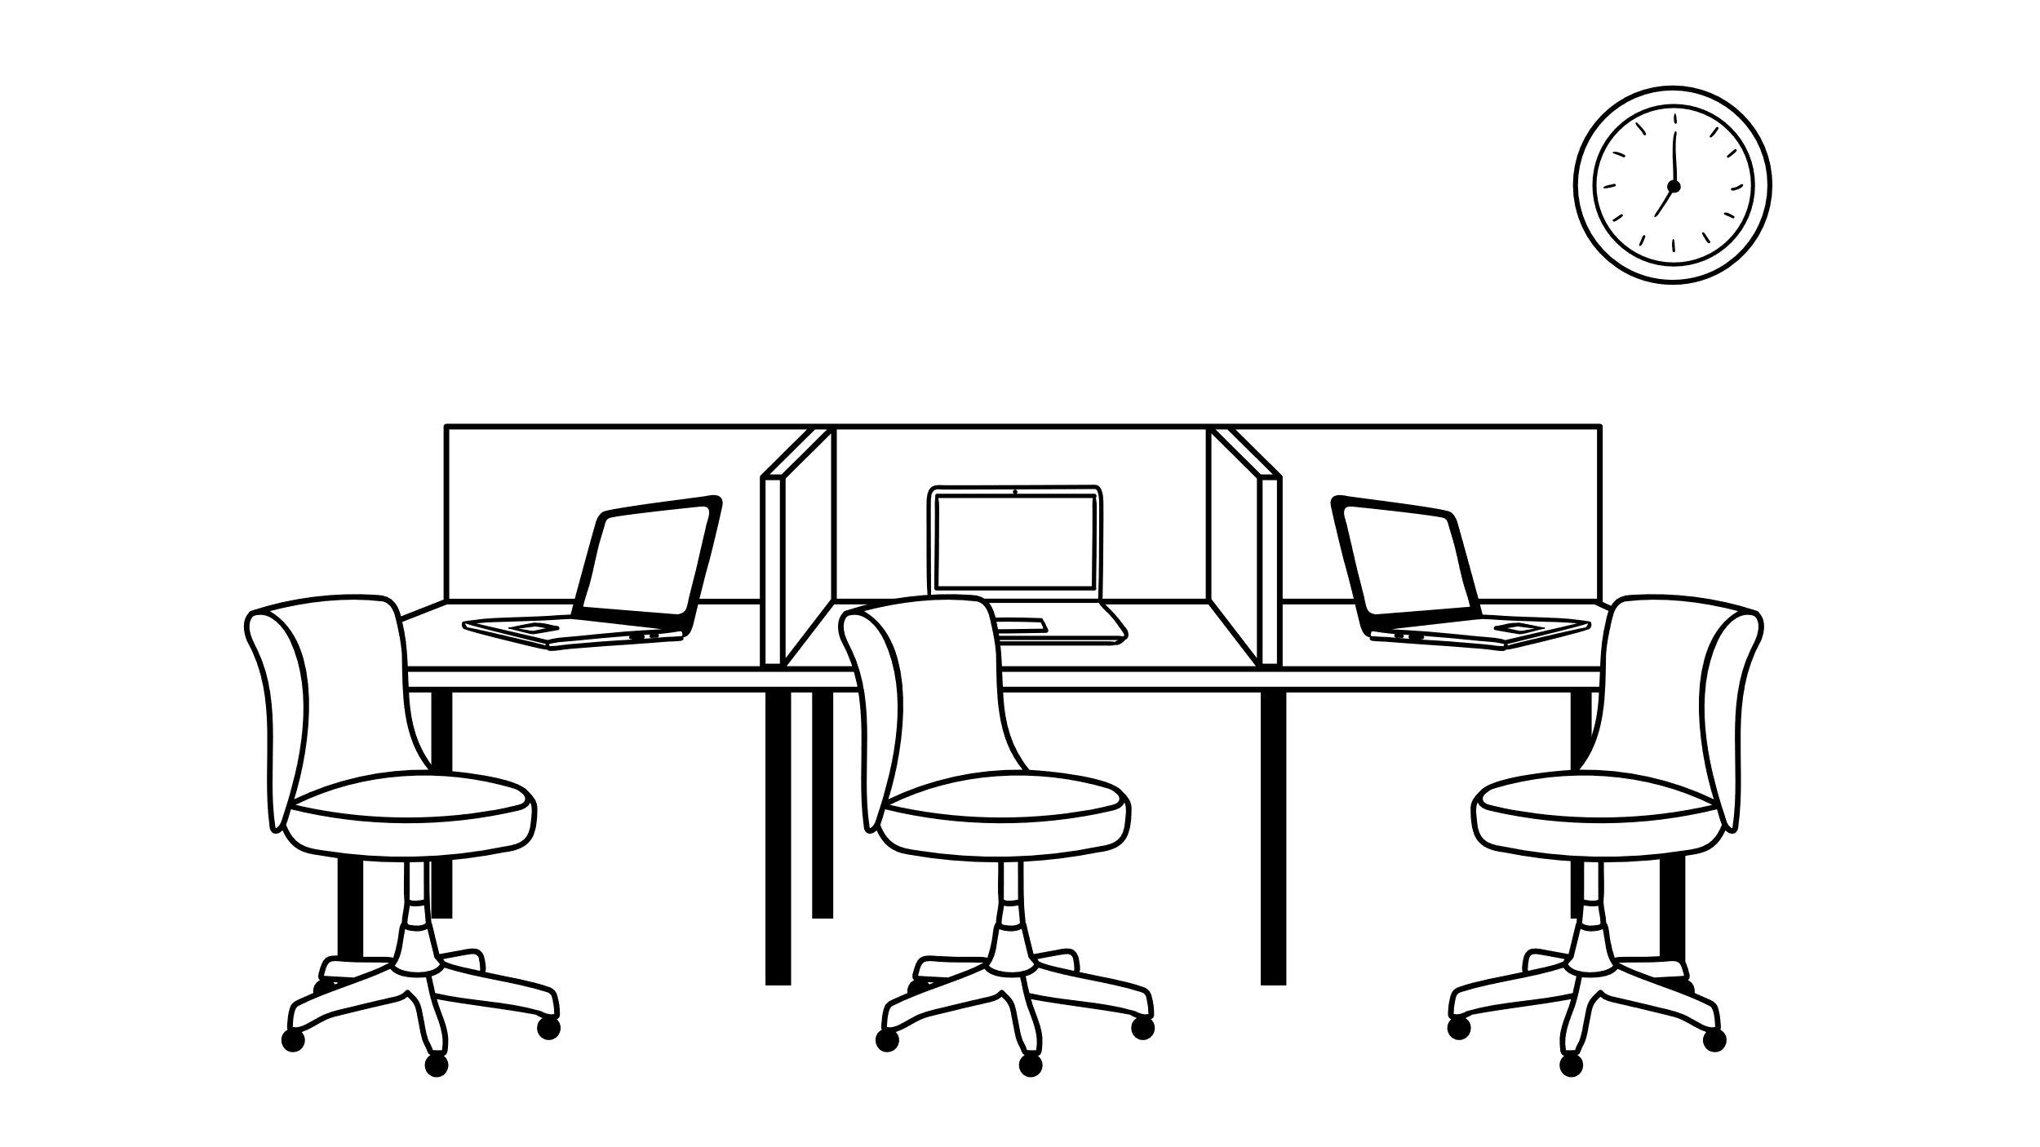
Rules and routines
Change of seminar groups (BA - info@sv.uio.no MA – post@stv.uio.no)
Compulsory activities
Absence
Facilitation due to special needs
Cheating and plagiarism
Notes:
Change of seminar groups: … is done by the administration, and students are not allowed to change groups after the deadline. They can apply from the 11th to the 23rd of January (today). If they have questions regarding this, please refer bachelor students to SV-info. Masters’ students can send an e-mail to post@stv.uio.no.
Compulsory activities: The compulsory activities in your course are listed on the course page. It’s important that you don’t confuse what’s compulsory and what’s strongly encouraged to the students. Double check the course page, since this is the information that has been approved by the Programråd. Get in touch if you’re unsure whether a student is meeting the compulsory requirements or not. In some cases where a student is in danger of failing on a qualifying assignment, the course coordinator must assess it.
Absence: Students must report absence from compulsory activities using the application form on the course page. We aim for equal treatment of all students across the different seminar groups; therefore, you must always refer students to the application form.
Facilitation due to special needs: Some students need facilitation. If they have contacted us in advance, you will be notified. If students ask you to facilitate (extra equipment/extra time/other support etc.), please inform them that we have a facilitation service. Bachelor students should contact SV-info and master students should send an e-mail to post@stv.uio.no.
Cheating and plagiarism: Students sometimes cheat. In seminars this usually concern plagiarism, either done on purpose or because students don’t know how to reference properly. It is therefore a good idea that you spend some time in the first seminar to talk about plagiarism and correct use of sources and citations. This is especially important in courses with international students, they might be used to very different citation practices. Inform me if you suspect cheating.

Slide 5

Contact info
For students:
info@sv.uio.no (BA)
post@stv.uio.no (MA)
For seminar leaders:
Course convener (academic questions)
Jenny (other questions)
  Who does what in the administration?
If you are ill:
Publish an announcement in Canvas, notify Jenny
Notes:
Jenny: If students have questions regarding administrative matters (absence, facilitation) refer bachelor students to SV-info. We must have a common policy towards all students and equal treatment is important, therefore they have one point of contact. Master students can email this address: post@stv.uio.no
Seminar leaders
Academic questions: course convener
Other questions: me
Check the link to “who does what in the administration”?
If you are ill:
Notify me and publish an announcement in Canvas that the seminar will be rescheduled. I will help you reschedule the seminar.

Slide 6

Challenges the students face
What challenges do students face in seminars?
How can seminars support students' learning in a university education?
Notes:
Siri: 5-10 min individual brainstorm → mikroskriveøvelse.

Slide 7

Break 20 minutes

Slide 8

Learning in higher education
BedreUndervisning
Notes:
Siri

Slide 9

What are some of the challenges students might face?
…
Notes:
Siri. Jenny take notes.

Slide 10
Key principles of learning

Slide 11
Learning
Understand key concepts
Learning environment
Motivation
Metacognition: insight to own knowledge and learning strategies
Feedback
Source: LINK- Senter for læring og utdanning (2022) Studenters Læring. BedreUndervisning
Notes:
Seminars as a perfect arena for all of these dimensions of learning – comments? Role of the seminar – plukke opp refleksjon: How can seminars support students' learning in a university education
Are trying to find the answer/explore a topic of interest
Mobilize prior knowledge
Applies knowledge
Make mistakes, and try again
Recieve feedback
Understand key concepts
Understand the Context
Active repeat
Are aware of our knowledge and working methods
Are part of a safe learning enviroment

Slide 12
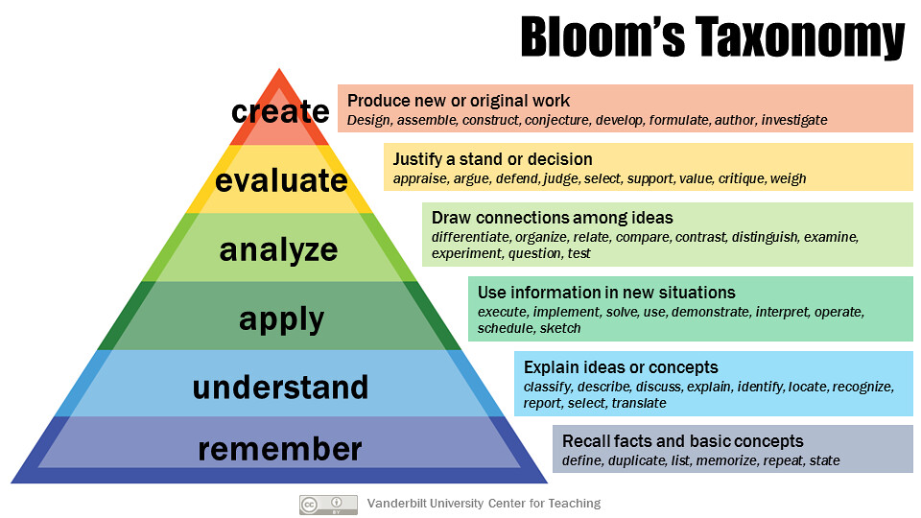
Notes:
Blooms taxonomi, 6 dimensions of learning – increases in complexity. Developed in order to create learning outcomes and guidelines for assesment. Can be a useful tool to structure and plan learning activties.
Which dimensions of learning will the students encounter in your seminars? Try to be concrete!

Slide 13
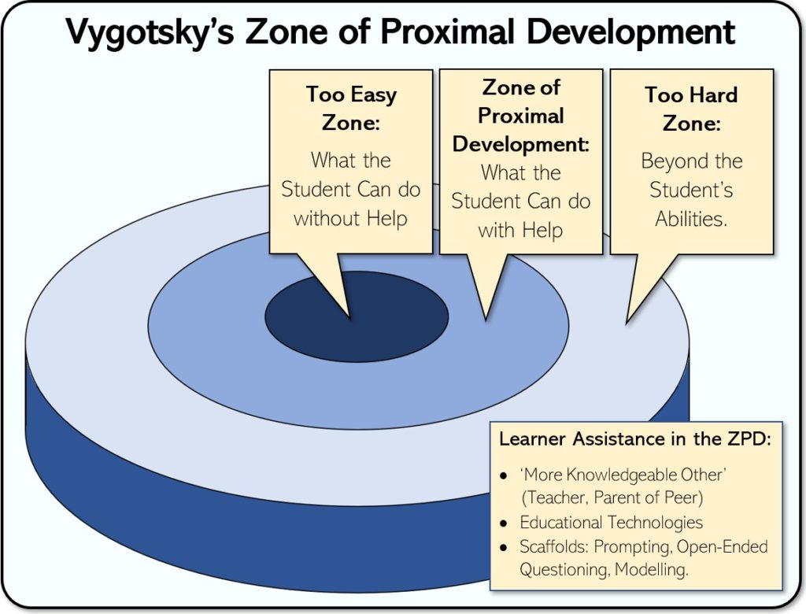

Slide 14
Scaffolding (Jerome Bruner)
based on a constructivist approach to learning: students construct meaning, knowledge and understanding through action and interaction.
the most important work is that which is done by the students themselves.
the scaffolding is a crucial framework for this work.
Scaffolding can and should be done before the students start their learning, but can also be adapted along the way.
Source: LINK- Senter for læring og utdanning (2022) Studenters Læring. BedreUndervisning

Slide 15
Scaffolding – how to
Clear direction and steps in the process/work
Structures for collaboration (e.g. meeting places, digital arenas, distribution of roles and responsibilities, clarification of expectations, training in collaboration).
Clear purpose of the activities: why should the students do this?
Recommended and available resources (literature, websites, examples, audiovisual material, etc.)
assessment and feedback
Source: LINK- Senter for læring og utdanning (2022) Studenters Læring. BedreUndervisning

Slide 16
Feedback and peer review

Slide 17
Feedback
Feedback as learning activities: BedreUndervisning (instructure.com)
Notes:
Variation: different forms of feedbak: self evalutation, peer review, comments by the teacher
Can be time consuming: how can you give the students feedback without working to much?
Scaffolding:
Do the students have the tools to give fruitful feedback?
Are the students trained to recieve the feedback and use it for improvement?
HoCs and LoCs

Slide 18
HOCs & LOCs
Higher order concerns
What do I want to say? How should I investigate it? ​
Storytelling, content, structure, argumentation
Lower order concerns
Explain the ideas to a reader.
Correct references.
Grammar, language.
Both are impotant, but HOCs before LOCs
Source: Ingerid Straume, Akademisk skrivesenter

Slide 19
Group dynamics and expectations

Slide 20
How would you would solve the following cases …?
I don’t know the answer to the student’s question.
Nobody is willing to speak in the plenary sessions.
Some individuals won’t let others chime in.
Too much time and too little content (and vice versa?).
The students haven’t done the necessary preparations.
Low attendance when there isn’t compulsory to show up.
Notes:
(if time) Jenny leads discussion. Siri takes notes on PPT. Here is a list of six typical cases. You are bound to encounter at least one of them in your seminars. Now, divide into groups of four to five people and choose minimum two cases.

Slide 21



Group roles
Task roles
Initiator-contributor
Personal Roles
Encourager
Dysfunctional Roles
Aggressor
Information seeker
Information giver
Opinion seeker
Opinion giver
Elaborator
Coordinator
Orienter
Evaluator/Critic
Energizer
Procedural Technician
Recorder
Harmonizer
Compromizer
Gategeeper/Expediter
Observer/Commentator
Follower
Blocker
Recognition Searcher
Self-Confessor
Disrupter
Dominator
Help Seeker
Special interest Pleader
Source: Benne, K.D. and Sheats, P. (1948), Functional Roles of Group Members. Journal of Social Issues, 4: 41-49. https://doi.org/10.1111/j.1540-4560.1948.tb01783.x
Notes:
Siri. Forventningsavklaring første møte. Roller og bevisstgjøring i samspill med studentene.
Initiator/Contributor – Proposes original ideas or different ways of approaching group problems or goals. This role initiates discussions and move groups into new areas of exploration.
Information Seeker – Requests clarification of comments in terms of their factual adequacy. Seeks expert information or facts relevant to the problem. Determines what information is missing and needs to be found before moving forward.
Information Giver – Provides factual information to the group. Is seen as an authority on the subject and relates own experience when relevant.
Opinion Seeker – Asks for clarification of the values, attitudes, and opinions of group members. Checks to make sure different perspectives are given.
Opinion Giver – Expresses his or her own opinions and beliefs about the subject being discussed. Often states opinions in terms of what the group “should” do.
Elaborator – Takes other people’s initial ideas and builds on them with examples, relevant facts and data. Also looks at the consequences of proposed ideas and actions.
Co-ordinator – Identifies and explains the relationships between ideas. May pull together a few different ideas and make them cohesive.
Orienter – Reviews and clarifies the group’s position. Provides a summary of what has been accomplished, notes where the group has veered off course, and suggests how to get back on target.
Evaluator/Critic – Evaluates proposals against a predetermined or objective standard. Assesses the reasonableness of a proposal and looks at whether it is fact-based and manageable as a solution.
Energizer – Concentrates the group’s energy on forward movement. Challenges and stimulates the group to take further action.
Procedural Technician – Facilitates group discussion by taking care of logistical concerns like where meetings are to take place and what supplies are needed for each meeting.
Recorder – Acts as the secretary or minute-keeper. Records ideas and keeps track of what goes on at each meeting.
Encourager – Affirms, supports, and praises the efforts of fellow group members. Demonstrates warmth and provides a positive attitude in meetings.
Harmonizer – Conciliates differences between individuals. Seeks ways to reduce tension and diffuse a situation by providing further explanations or using humor.
Compromiser – Offers to change his or her position for the good of the group. Willing to yield position or meet others half way.
Gatekeeper/Expediter – Regulates the flow of communication. Makes sure all members have a chance to express themselves by encouraging the shy and quiet members to contribute their ideas. Limits those who dominate the conversation and may suggest group rules or standards that ensure everyone gets a chance to speak up.
Observer/Commentator – Provides feedback to the group about how it is functioning. Often seen when a group wants to set, evaluate, or change its standards and processes.
Follower – Accepts what others say and decide even though he or she has not contributed to the decision or expressed own thoughts. Seen as a listener not a contributor.
Aggressor – Makes personal attacks using belittling and insulting comments, for example, “That’s the most ridiculous idea I’ve ever heard.” Actions are usually an attempt to decrease another member’s status.
Blocker – Opposes every idea or opinion that is put forward and yet refuses to make own suggestions, for example, “That’s not a good idea.” The result is that the group stalls because it can’t get past the resistance.
Recognition Seeker – Uses group meetings to draw personal attention to him or herself. May brag about past accomplishments or relay irrelevant stories that paint him or her in a positive light. Sometimes pulls crazy stunts to attract attention like acting silly, making excess noise, or otherwise directing members away from the task at hand.
Self-Confessor – Uses the group meetings as an avenue to disclose personal feelings and issues. Tries to slip these comments in under the guise of relevance, such as “That reminds me of a time when.” May relate group actions to his or her personal life. For example, if two others are disagreeing about something, the Self-confessor may say, “You guys fight just like me and my wife.”
Disrupter/Playboy or Playgirl – Uses group meetings as fun time and a way to get out of real work. Distracts other people by telling jokes, playing pranks, or even reading unrelated material.
Dominator – Tries to control the conversation and dictate what people should be doing. Often exaggerates his or her knowledge and will monopolize any conversation claiming to know more about the situation and have better solutions than anybody else.
Help Seeker – Actively looks for sympathy by expressing feelings of inadequacy. Acts helpless, self deprecating and unable to contribute. For example, “I can’t help you, I’m too confused and useless with this stuff.”
Special Interest Pleader – Makes suggestions based on what others would think or feel. Avoids revealing his or her own biases or opinions by using a stereotypical position instead, for example, “The people over in Admin sure wouldn’t like that idea.” or “You know how cheap our suppliers are, they won’t go for that.”

Slide 22
Setting the scene: expectations
Your expections towards the students?
What can the students expect from you?
How will you establish ground rules?
What will you do if the group break the rules ?

Slide 23
Excercises

Slide 24

Different exercises
Rounds
  Each has to say at least one thing about the text/theme/concept, and then the next person can say something new or add on what has been said. Prepare them for this in advance to avoid stress.
Three-step-method or Think, pair (square), share
  Pre-prepared questions: 1. three minutes of individual reflection, 2. ten minutes of discussion in smaller groups, 3. ten minutes of plenary summary.
Alias
  In advance, write down key words/concepts on several pieces of paper. Divide the students into smaller groups and let them explain to each other the notes without them actually saying the word they pick. The game is to be the first to guess what the person is trying to explain. A fun memo technique close to the exam!
Notes:
Jenny + Siri

Slide 25
Writing exercises
Writing for thinking
Writing for presentation
“Think with the pen"
Explore, creative, develop ideas
No formal requirements
Part of a process
Written for oneself or for well-intentioned recipients
Should not be formally evaluated
Communicate, showcase, perform.
Strict requirements for presentation (genre, style, referencing)
Focus on the product.
Written for an outsider.
Read critically and should be formally evaluated

Slide 26
Tecniques
Tools
Ressursside for seminarledere ISV
Study skills | Search & Write (sokogskriv.no)
Getting started | Search & Write (sokogskriv.no)
BedreUndervisning (LINK)
Group activities (LINK)
Six Thinking Hats – Edward De Bono
MS Whiteboard
https://miro.com/
Mentimeter
Talkwall
Tool for planning a teaching session

Slide 27
Thank you for evaluating this meeting! https://nettskjema.no/a/310047

